Slide 1
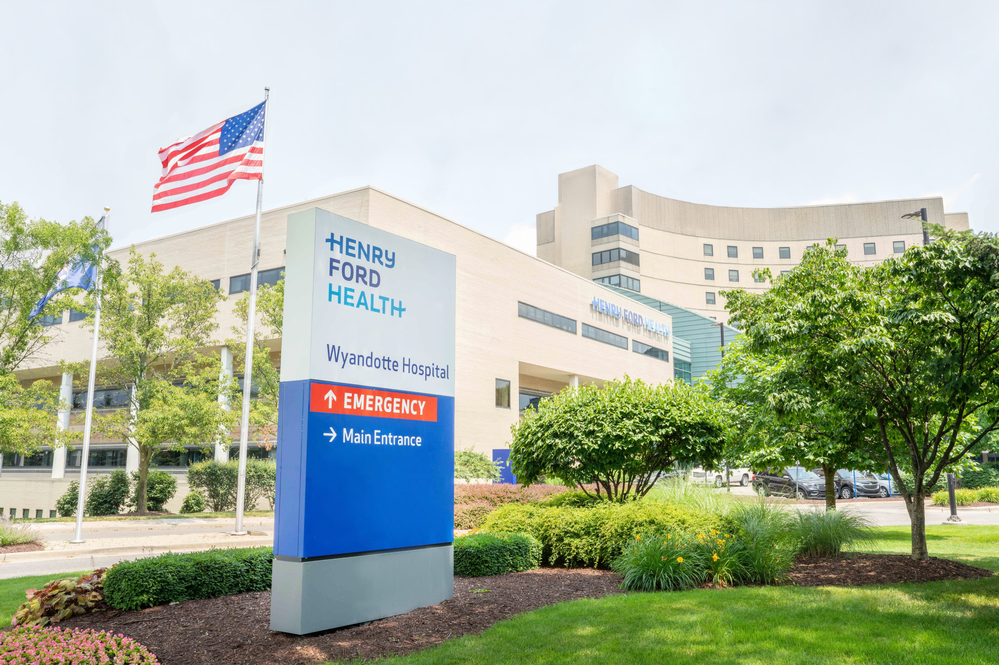
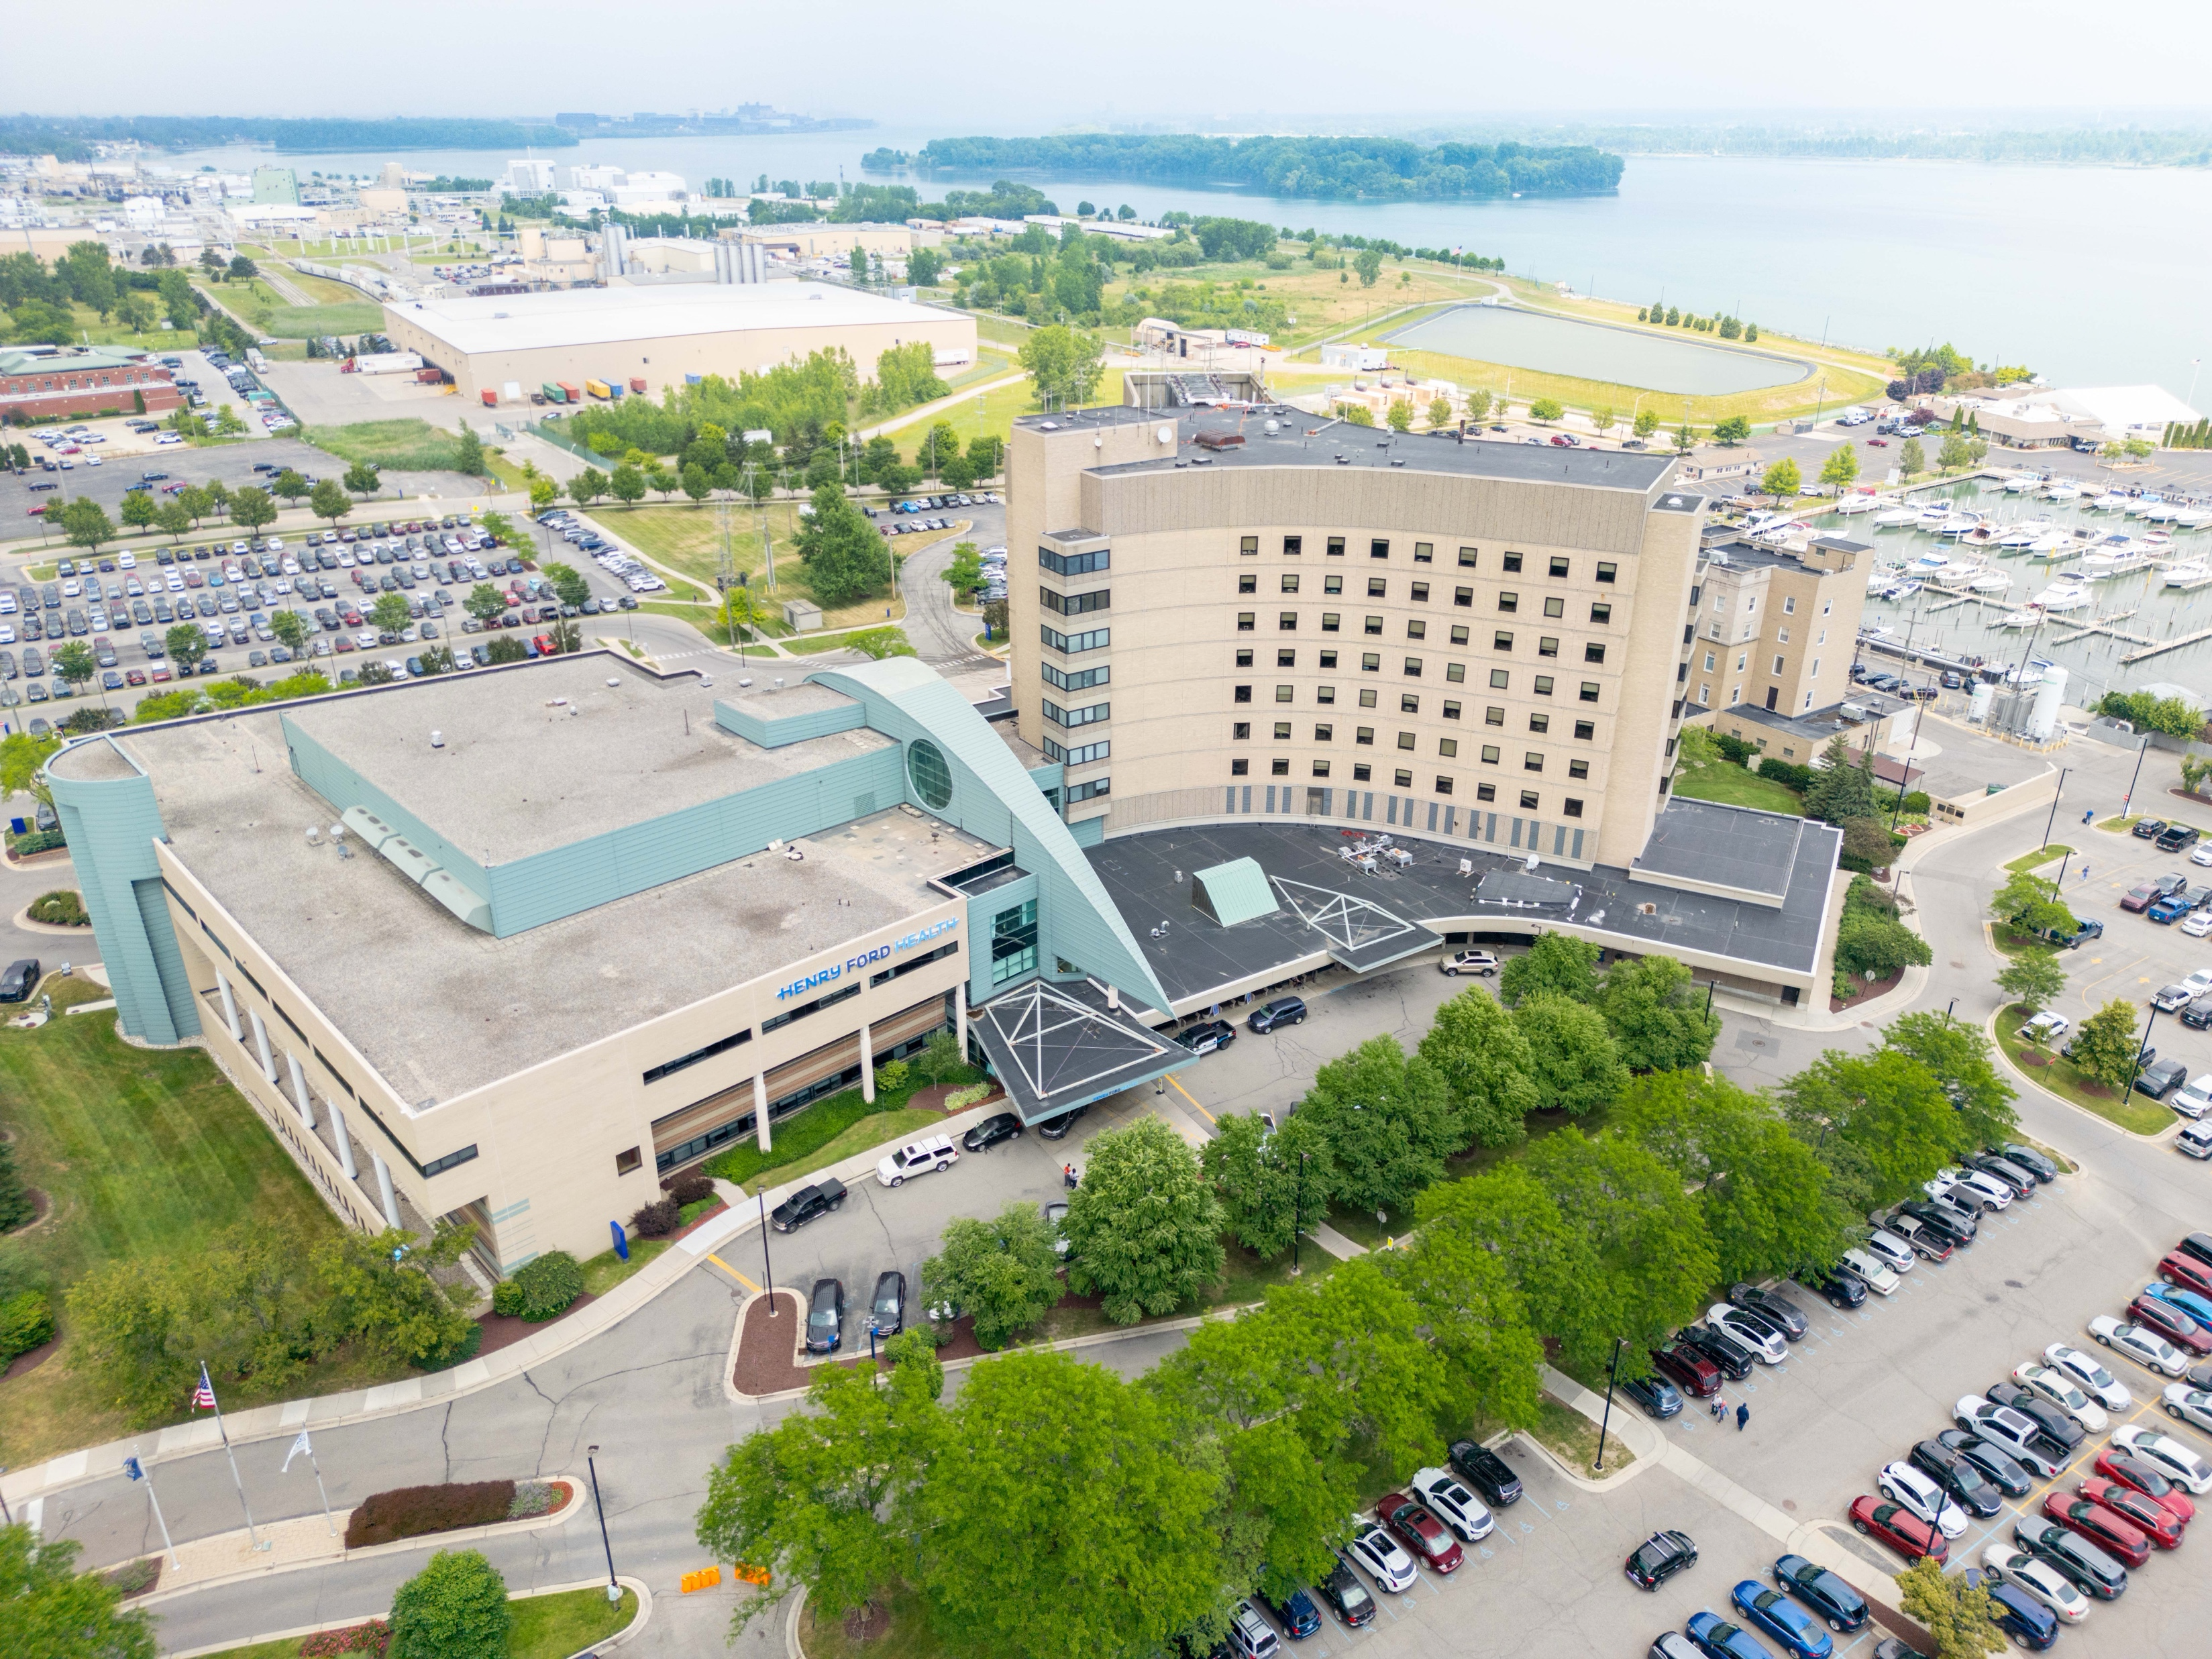
Emergency Medicine Residency Publications
Celebrating 20 Years of Research and Scholarly Activity
Henry Ford Wyandotte Hospital
Department of Emergency Medicine

Slide 2
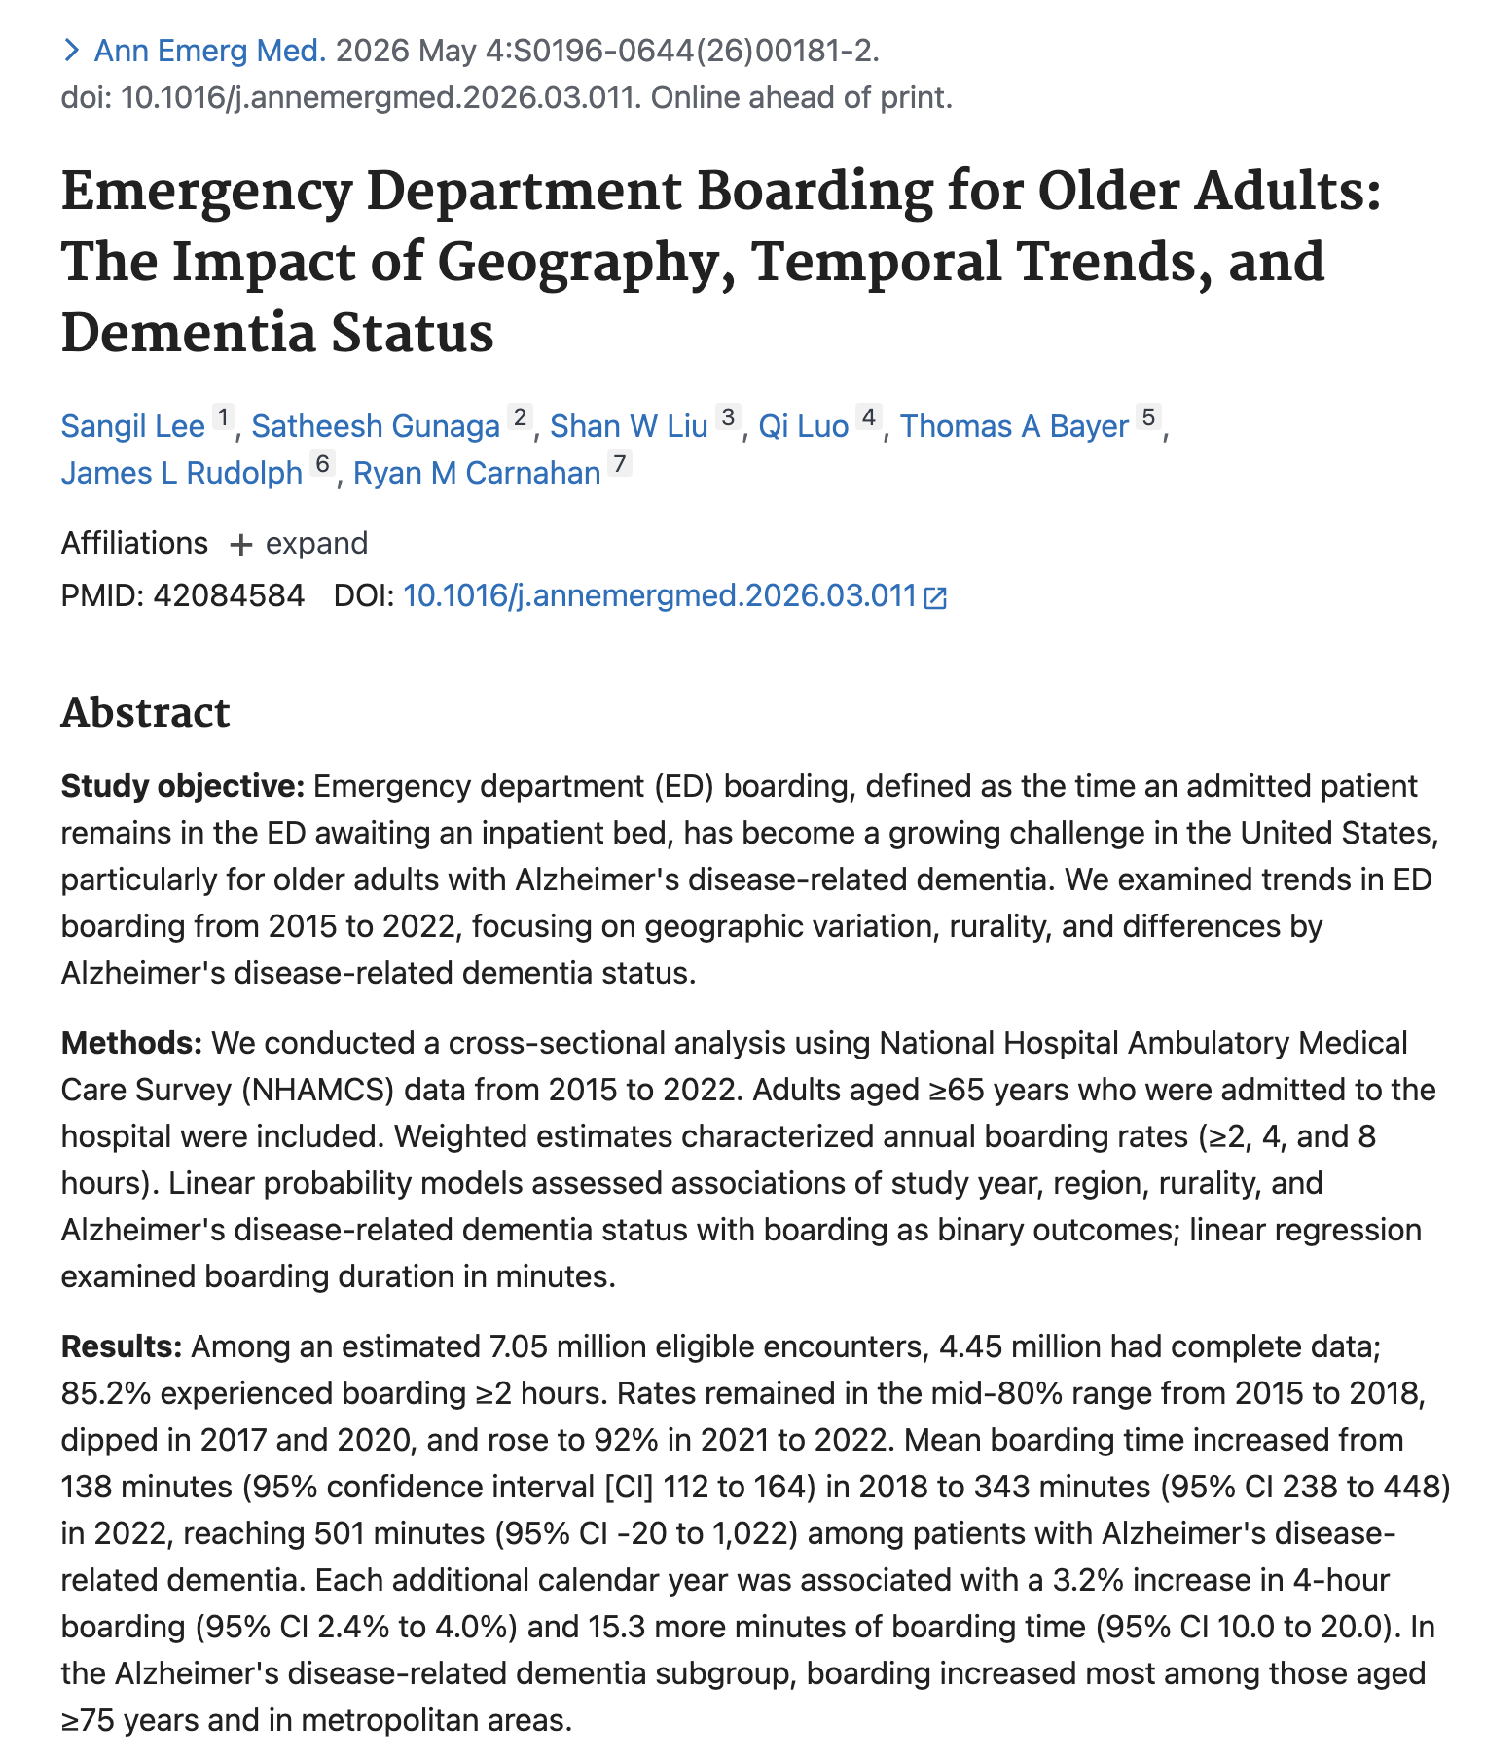
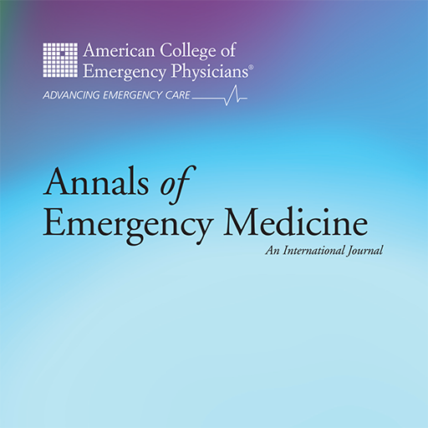
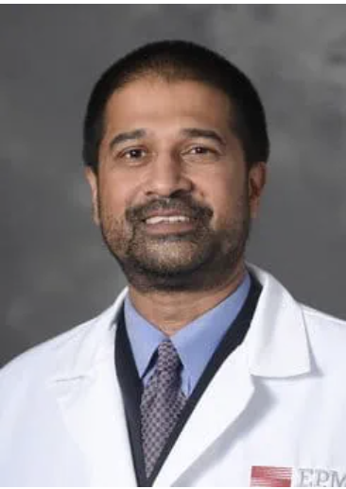

Emergency department boarding for older adults: the impact of geography, temporal trends, and dementia status
Sangil Lee, MD, Satheesh Gunaga, DO, Shan Liu, MD, Qi Luo, PhD, Thomas Bayer, MD, James Rudolph, MD
Annals of Emergency Medicine, 2026
Published in Annals of Emergency Medicine, May, 2026

Slide 3
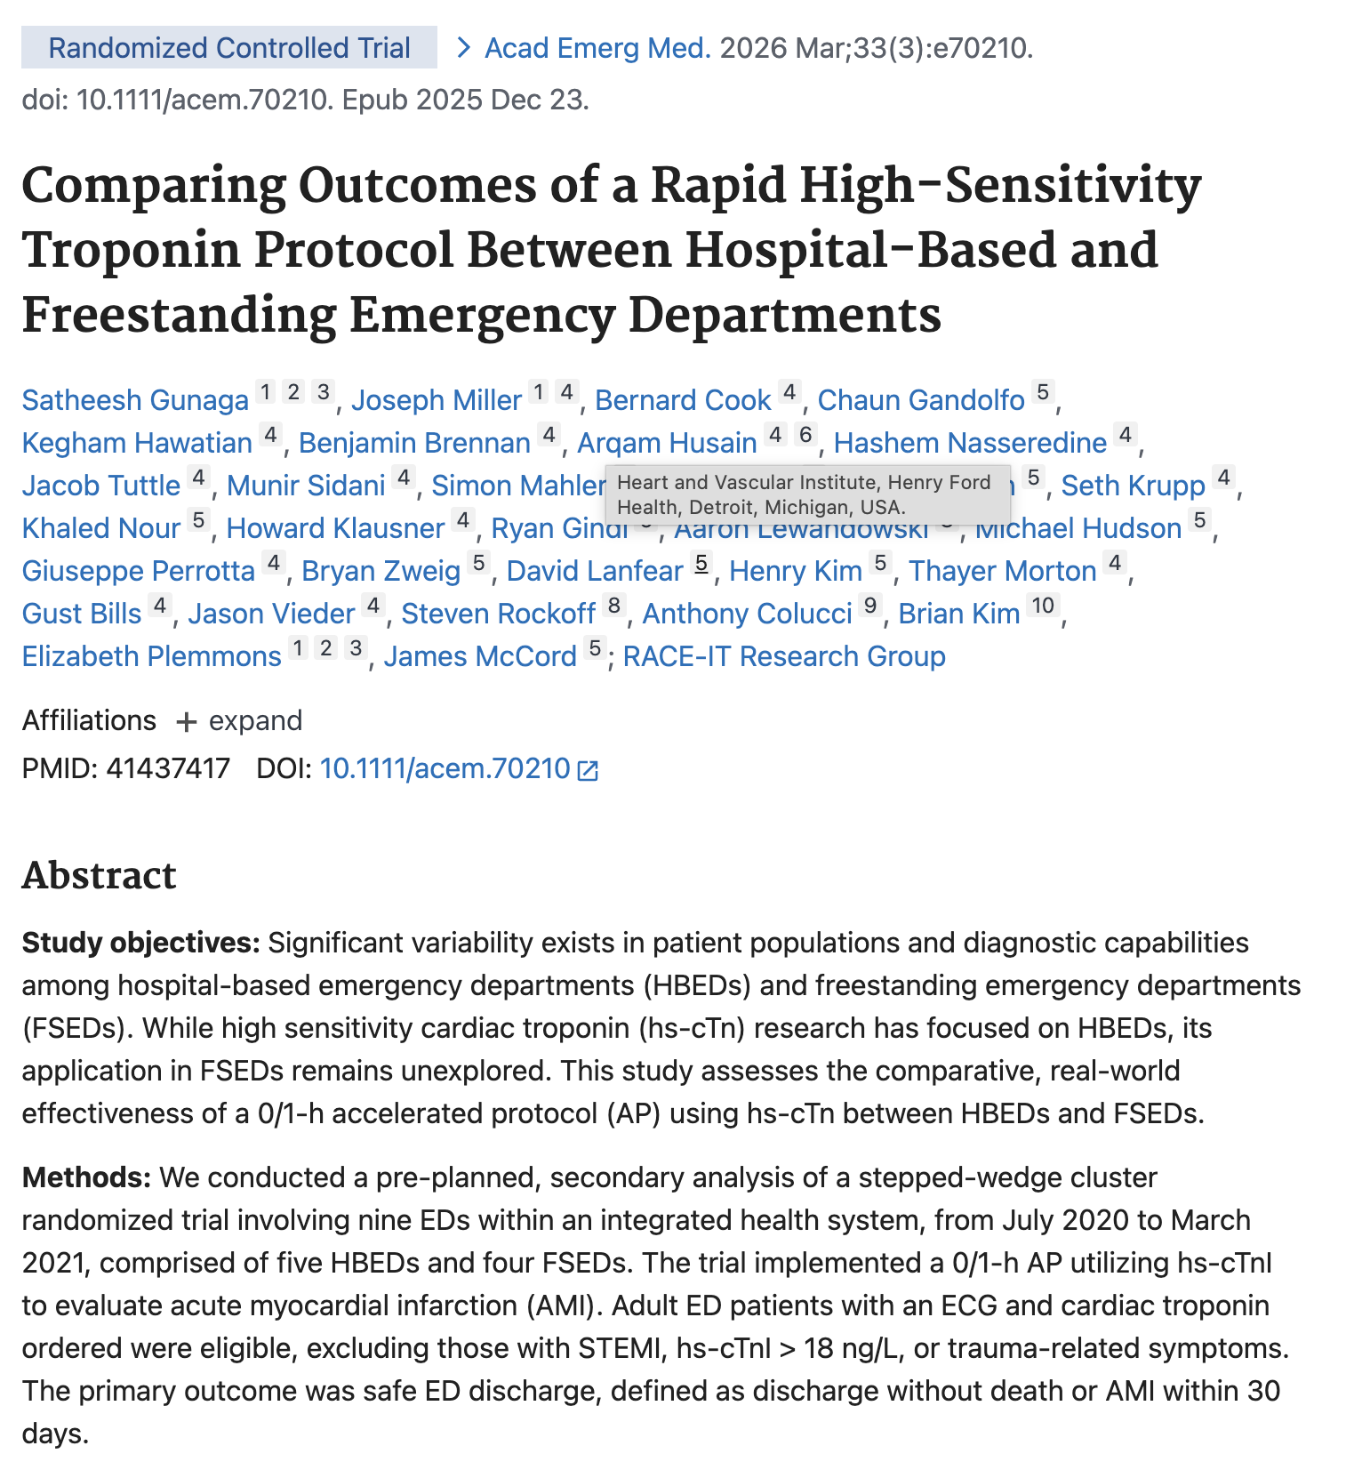

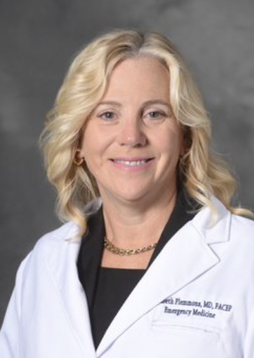
Comparing outcomes of a rapid high-sensitivity troponin protocol between hospital-based and freestanding emergency departments
Satheesh Gunaga, DO, Joseph Miller, MD, Elizabeth Plemmons, MD, Bernard Cook, PhD, Chaun Gandolfo, DO, Kegham Hawatian, MD
Manuscript Published in February 2026: Academic Emergency Medicine
Elizabeth Plemmons, MD
Department of Emergency Medicine
Henry Ford Wyandotte Hospital
Published in Academic Emergency Medicine, February 2026, Volume 33, Issue 3

Slide 4
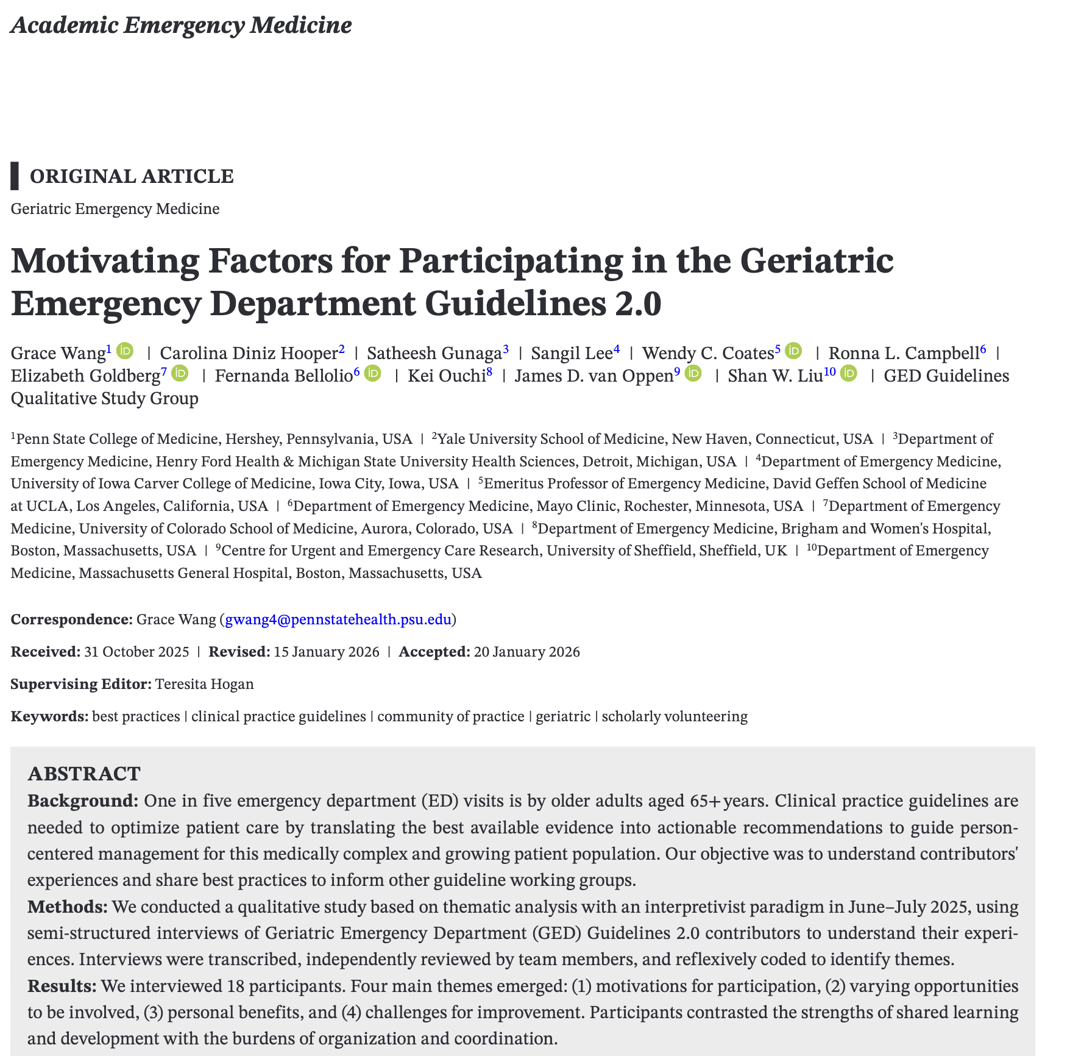

Motivating Factors for Participating in the Geriatric Emergency Department Guidelines 2.0
Grace Wang, MD, Carolina Diniz Hooper, MD, Satheesh Gunaga, DO, Sangil Lee, MD, Wendy Coates, MD
Manuscript Published in February 2026: Academic Emergency Medicine
Satheesh Gunaga, DO, FACEP, FACOEP
Department of Emergency Medicine
Henry Ford Wyandotte Hospital
2005-Present
Published in Academic Emergency Medicine, February 2026, Volume 33, Issue 2

Slide 5
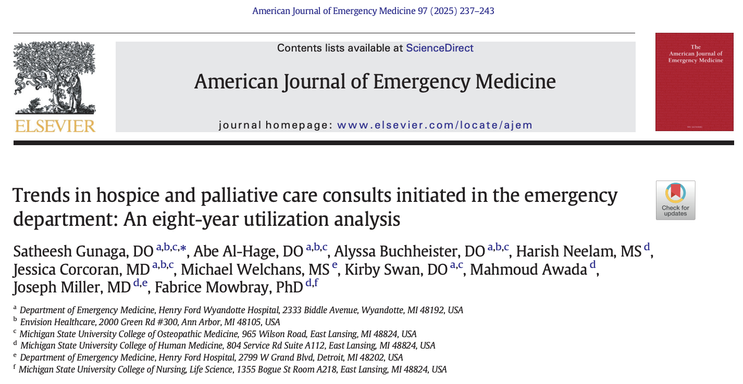
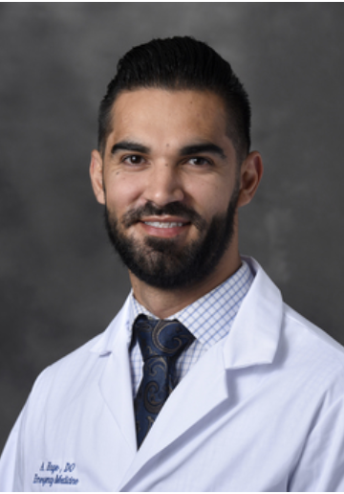

Trends in hospice and palliative care consults initiated in the emergency department: an eight-year utilization analysis
Satheesh Gunaga, DO, Abe Al-Hage, DO, Alyssa Buchheister, DO, Jessica Corcoran, MD, Kirby Swan DO, Joseph Miller, MD
Manuscript Published in November of 2025: American Journal of Emergency Medicine
Abe Al Hage, DO
Department of Emergency Medicine
Henry Ford Wyandotte Hospital
2020 - Present

Slide 6
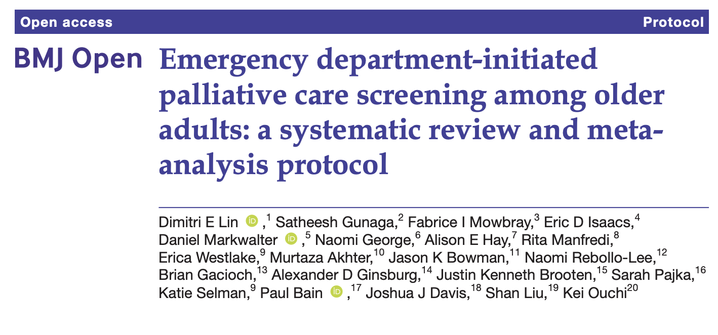
Emergency department-initiated palliative care screening among older adults: a systematic review and meta-analysis protocol
Dimitri Lin, MD, Satheesh Gunaga, DO, Fabrice Mowbray, PhD, Eric Isaacs, MD, Daniel Markwalter, MD, Naiomi, George MD
Manuscript Published in October 2025: British Medical Journal Open
Satheesh Gunaga, DO, FACEP, FACOEP
Department of Emergency Medicine
Henry Ford Wyandotte Hospital
2005-Present

Slide 7
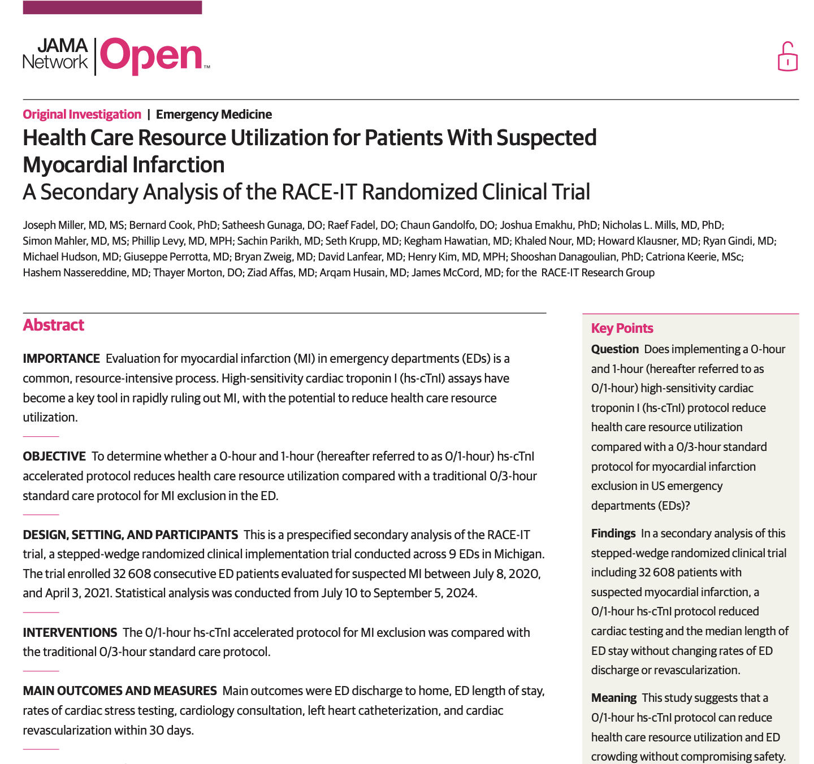
Health Care Resource Utilization for Patients With Suspected Myocardial Infarction
Joseph Miller, MD, Bernard Cook, PhD, Satheesh Gunaga, DO, Raef Fadel, DO, Chaun Gandolfo, DO, Joshua Emakhu, PhD
Manuscript Published in April 2025: JAMA Open
Satheesh Gunaga, DO, FACEP, FACOEP
Department of Emergency Medicine
Henry Ford Wyandotte Hospital
2005-Present

Slide 8
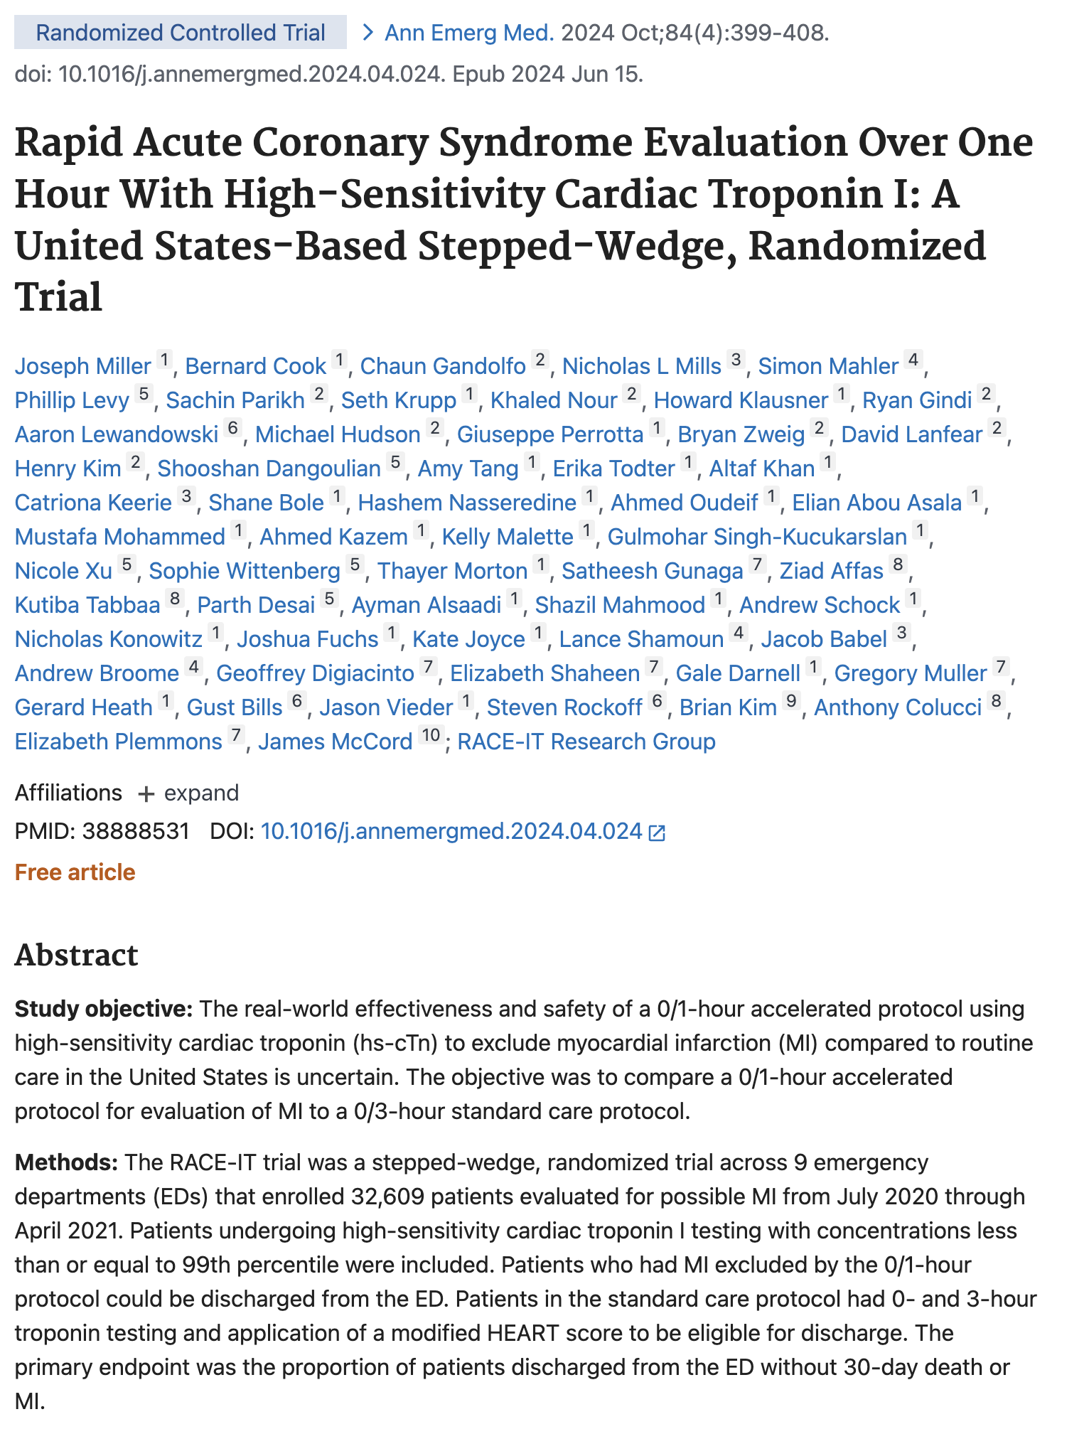
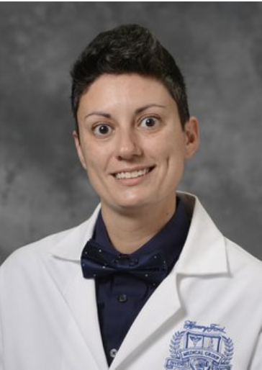
Rapid ACS evaluation over one hour with high-sensitivity cardiac troponin: a U.S.-based stepped-wedge RCT
Joseph Miller, MD, Satheesh Gunaga, DO, Elizabeth Plemmons, MD, Elizabeth Shaheen, MD, Gale Darnell, MD, James Babel, DO, Andrew Broome, DO, Lance Shamoon, DO
Annals of Emergency Medicine, 2024
Dr. Elizabeth Shaheen, MD
Department of Emergency Medicine
Henry Ford Wyandotte Hospital
Published in Annals of Emergency Medicine, June, 2024

Slide 9
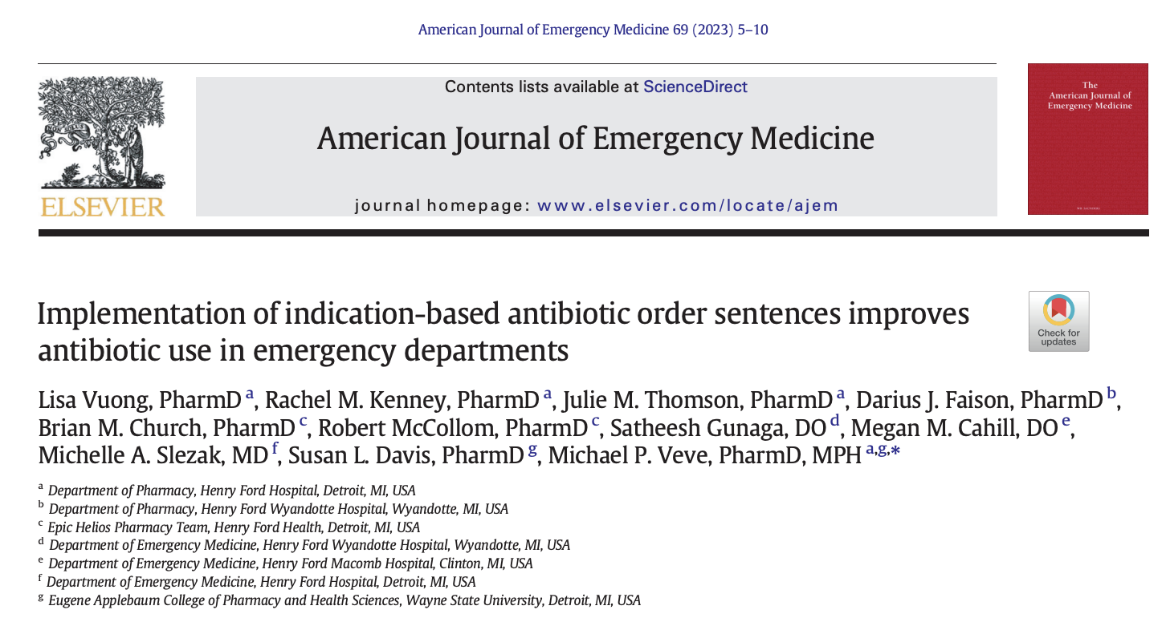
Implementation of indication0based antibiotic order sentences improves antibiotic use in emergency departments
Lisa Vuong, PharmD, Rachel Kenney, PharmD, Julie Thomson, PharmD, Darius Faison, PharmD, Satheesh Gunaga, DO
Manuscript Published in July of 2023: American Journal of Emergency Medicine
Dr. Satheesh Gunaga, DO, FACEP, FACOEP
Department of Emergency Medicine
Henry Ford Wyandotte Hospital
2005 - Present

Slide 10
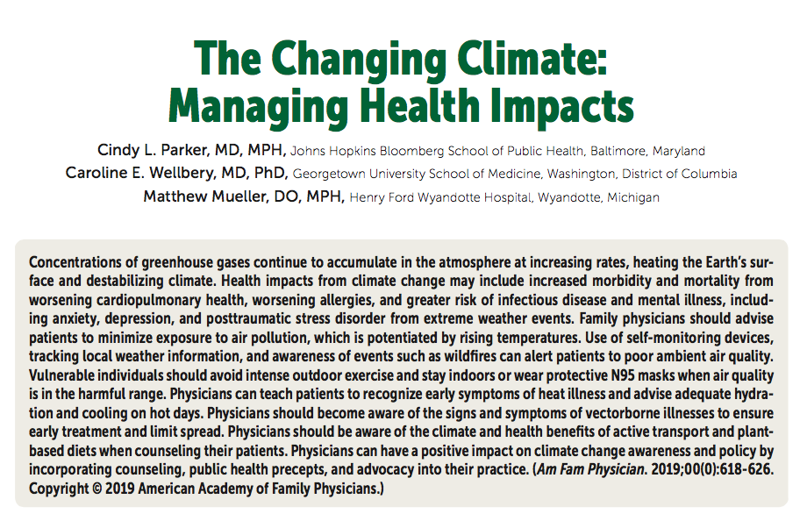
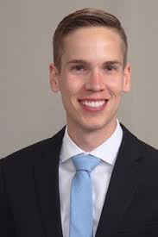


The Changing Climate: Managing Health Impacts
Manuscript Published in November 2019: American Family Physician
Mathew Mueller, DO, MPH
Department of Emergency Medicine
Henry Ford Wyandotte Hospital
2017-2020

Slide 11
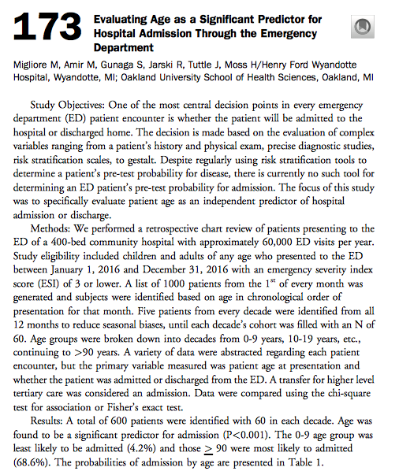
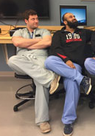
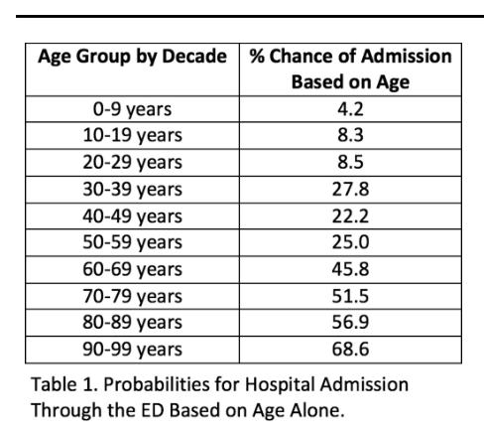
Evaluating Age as a Significant Predictor for Hospital Admission Through the Emergency Department
Marcello Migliore, DO, Mahammad Amir, DO, Zachary Shaver, DO Satheesh Gunaga, DO
Abstract Published in October 2019: Annals of Emergency Medicine
Published in Annals of Emergency Medicine, Oct. 2019, Volume 74, pg. S68
Presented Nationally at ACEP Scientific Assembly, October 2019.
Presented Regionally at Henry Ford Medical Education Research Forum in May 2020

Slide 12
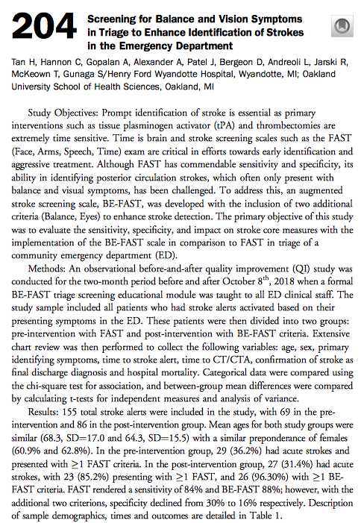
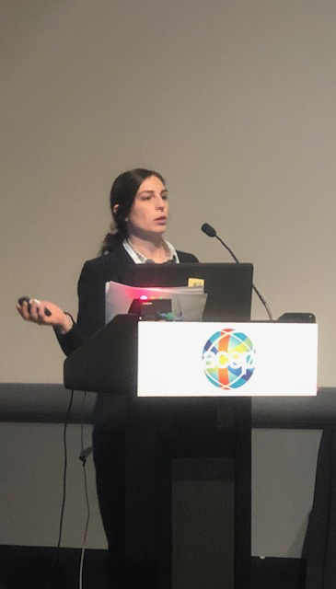
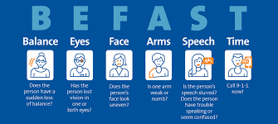
Screening for Balance and Vision Symptoms in Triage to Enhance Identification of Strokes in the the Emergency Department
Henry Tan, DO, Caroline Hannon, DO, Anu Gopalan, DO, Adam Alexander, DO, Thomas McKeown, MD, Satheesh Gunaga, DO
Abstract Published in October 2019: Annals of Emergency Medicine
Published in Annals of Emergency Medicine, Oct. 2019, Volume 74, pg. S81
Presented Nationally at ACEP Scientific Assembly, October 2019.
Presented Regionally at Henry Ford Medical Education Research Forum in April 2019
Presented Regionally at Michigan Osteopathic Association Research Forum in April 2019

Slide 13
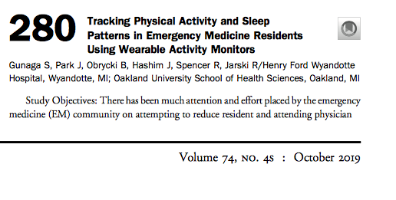
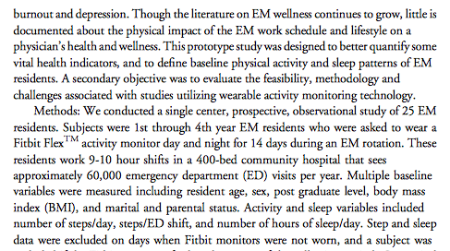
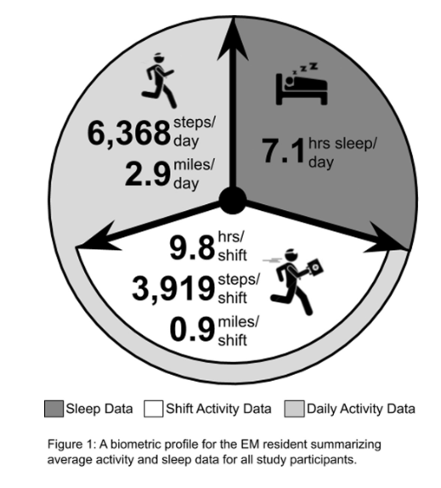
Tracking Physical Activity and Sleep Patterns in Emergency Medicine Residents Using Wearable Activity Monitors
Satheesh Gunaga, DO, Jesse Park, DO, Brian Obrycki, DO, Ryan Spencer, DO
Abstract Published in October 2019: Annals of Emergency Medicine
Published in Annals of Emergency Medicine, Oct. 2019, Volume 74, pg. S110
Presented Nationally at ACEP Scientific Assembly, October 2019.
Presented Regionally at Henry Ford Medical Education Research Forum in May 2020
Presented Regionally at Michigan Osteopathic Association Research Forum in April 2019

Slide 14
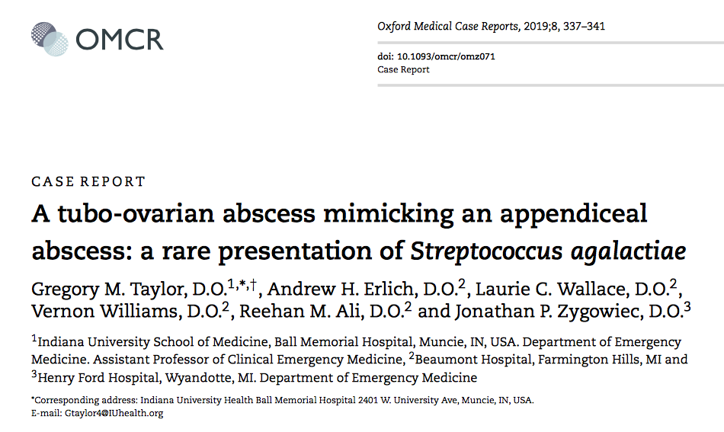
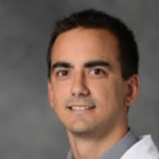

A Tubo-Ovarian Abscess Mimicking an Appendiceal Abscess: A Rare Presentation of Streptococcus Agalactiae
Manuscript Published in August 2019: Oxford Medical Case Reports
Jonathan Zygowiec, DO
Department of Emergency Medicine
Henry Ford Wyandotte Hospital
2016-2019

Slide 15
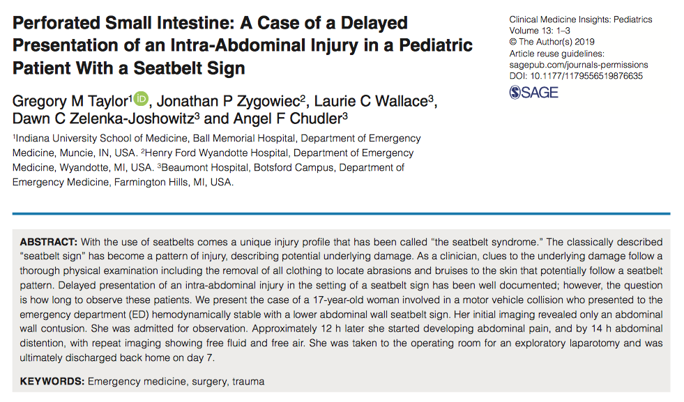
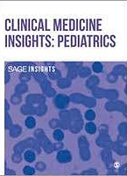
Perforated Small Intestine: A Case of a Delayed Presentation of an Intra-Abdominal Injury in a Pediatric Patient with a Seatbelt Sign
Manuscript Published in August 2019: Clinical Medicine Insights: Pediatrics
Jonathan Zygowiec, DO
Department of Emergency Medicine
Henry Ford Wyandotte Hospital
2016-2019

Slide 16
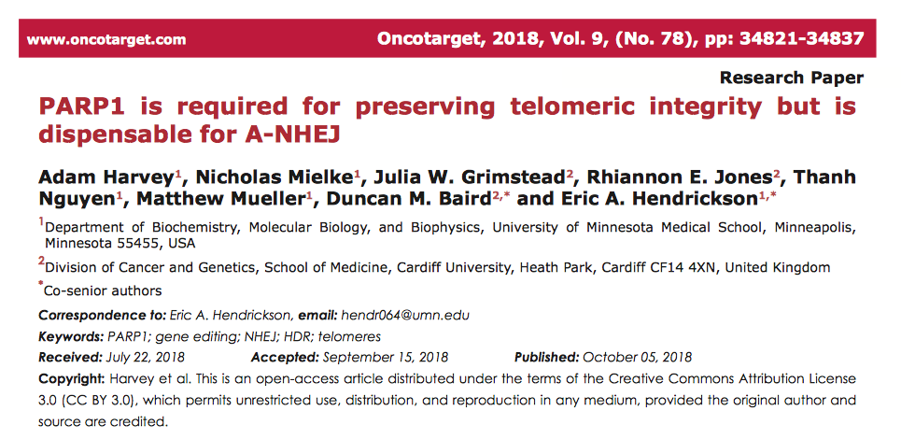

PARP1 is Required for Preserving Telomeric
Integrity but is Dispensable for A-NHEJ
Manuscript Published in October 2018: Oncotarget
Mathew Mueller, DO, MPH
Department of Emergency Medicine
Henry Ford Wyandotte Hospital
2017-2020

Slide 17
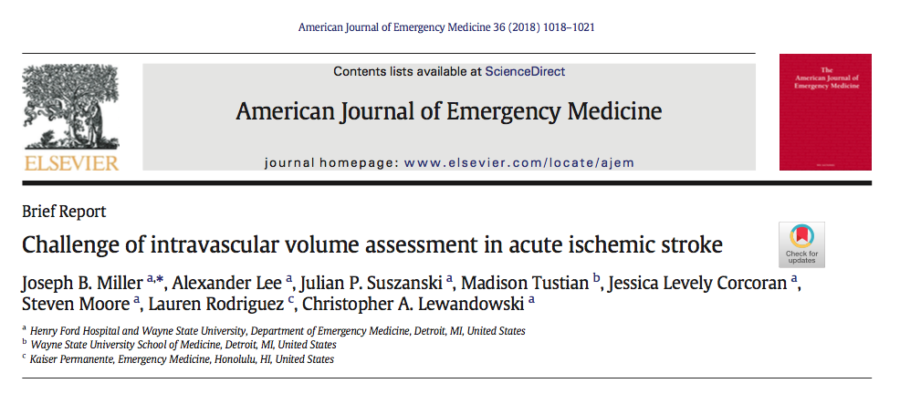
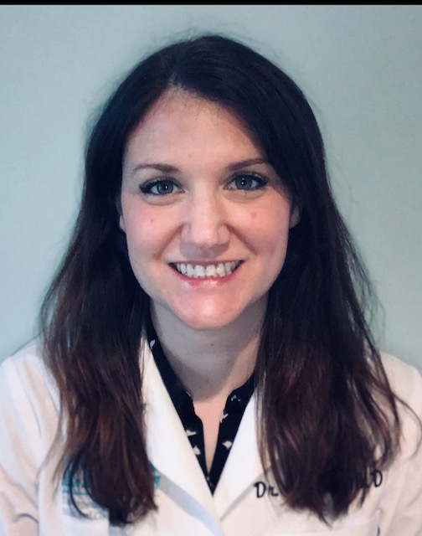
Challenge of Intravascular Volume
Assessment in Acute Ischemic Stroke
Manuscript Published in March of 2018: American Journal of Emergency Medicine
Jessica Corcoran, MD
Department of Emergency Medicine
Henry Ford Wyandotte Hospital
2015 - Present

Slide 18
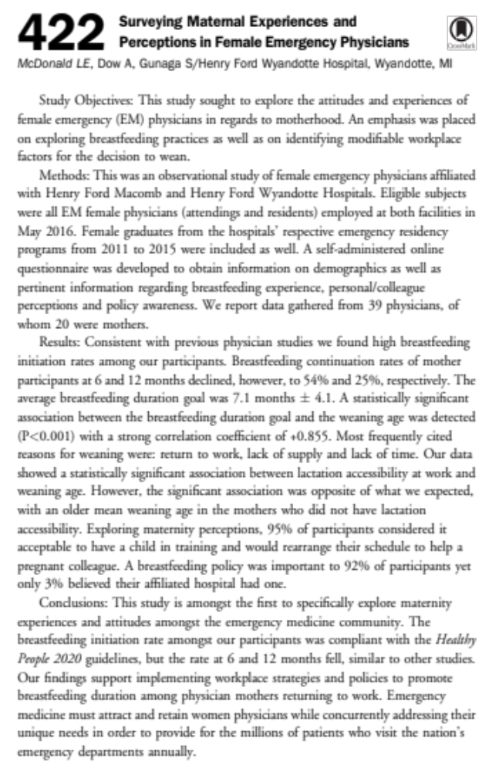

Surveying Maternal Experiences and Perceptions in Female Emergency Physicians
Lindsey McDonald, DO, Agata Dow, MD, Zachary Illg, DO, Satheesh Gunaga, DO
Abstract Published in October 2017: Annals of Emergency Medicine
Agata Dow, MD
Department of Emergency Medicine
Henry Ford Wyandotte Hospital
2012 - Present
Published in Annals of Emergency Medicine, Oct. 2017, pg. S840
Presented Nationally at ACEP Scientific Assembly, October 2017.
Presented Regionally at Henry Ford Medical Education Research Forum in April 2018
Presented Regionally at EMRAM Research Forum in April 2017

Slide 19
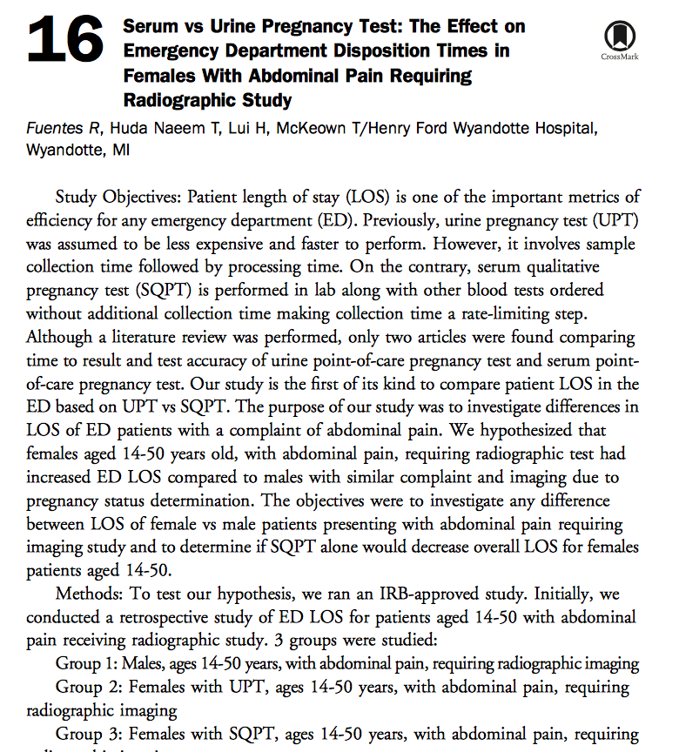

Serum vs Urine Pregnancy Test: The Effect on Emergency Department Disposition Times in Females with Abdominal Pain Requiring Radiographic Study
Rachel Fuentes, DO, Huda Naeem, DO, Houston Lui, DO, Thomas Mckeown, MD
Abstract Published in October 2017: Annals of Emergency Medicine
Thomas McKeown, MD, FACEP
Department of Emergency Medicine
Henry Ford Wyandotte Hospital
2003 - Present
Published in Annals of Emergency Medicine, Oct. 2017, pg. S7
Presented Nationally at ACEP Scientific Assembly, October 2017.
Presented Regionally at MSU COM State Wide Campus Research Forum in May of 2017. Won First Prize in QI Category.
Presented Regionally at Henry Ford Medical Education Research Forum in April 2018

Slide 20
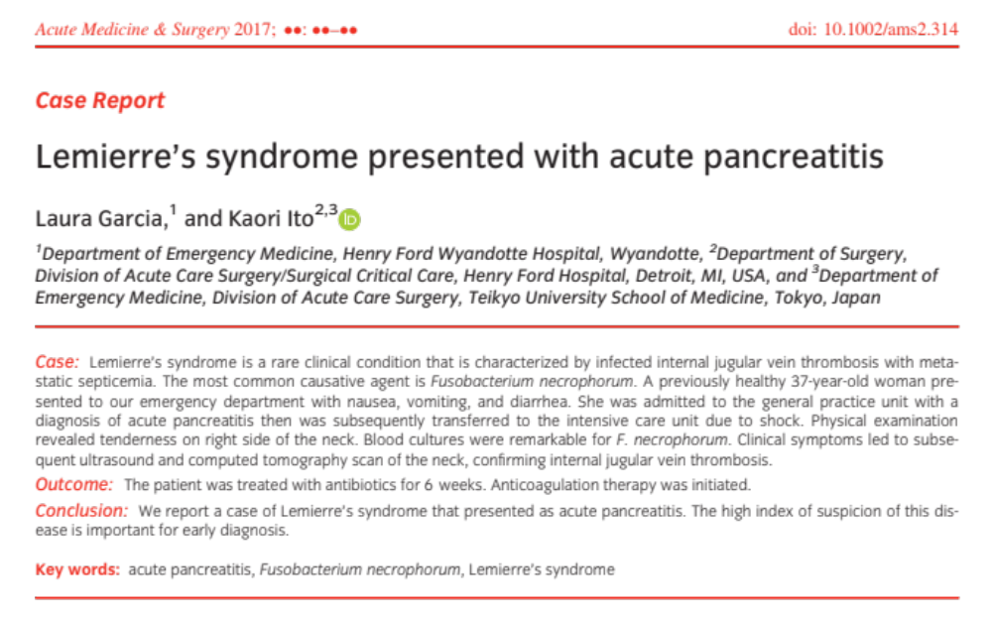
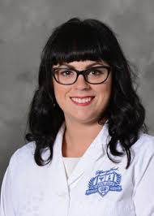
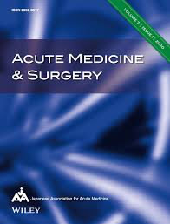
Lemierre’s Syndrome Presented with Acute Pancreatitis
Published in Winter 2017: Acute Medicine and Surgery
Laura Garcia, DO, MPH
Department of Emergency Medicine
Henry Ford Wyandotte Hospital
2015 - Present

Slide 21
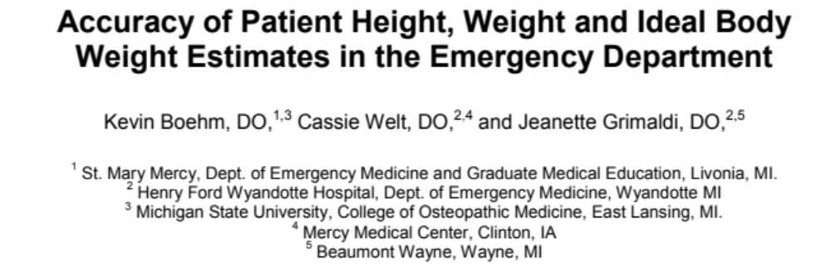


Accuracy of Patient Height, Weight and Ideal Body Weight Estimates in the Emergency Department
Published in Winter 2017: Spartan Medical Research Journal
Cassie Welt, DO
Department of Emergency Medicine
Henry Ford Wyandotte Hospital
2011 - 2015

Slide 22
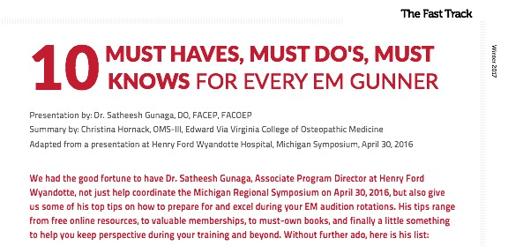
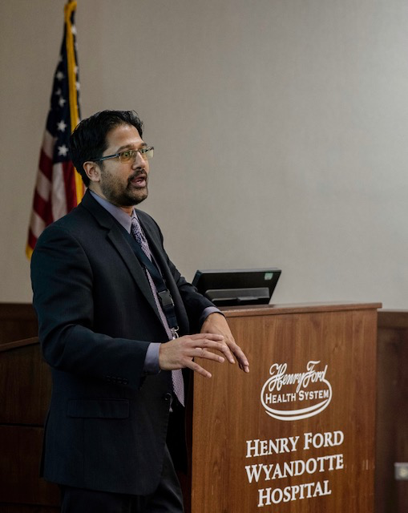
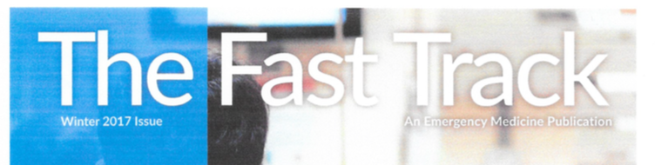
10 Must Haves, Must DO’s, Must Knows For Every EM Gunner
Published in Winter 2017: The Fast Track
Satheesh Gunaga, DO, FACEP, FACOEP
Department of Emergency Medicine
Henry Ford Wyandotte Hospital
2005 - Present

Slide 23
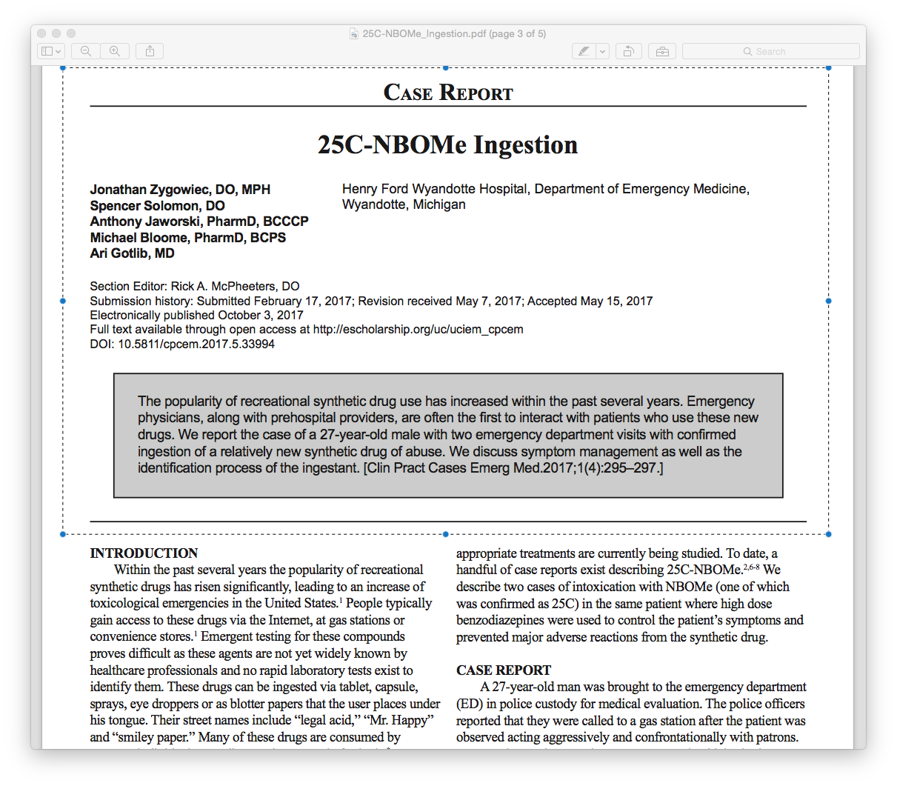


25C–NBOMe Ingestion
Published in October 2017: Western Journal Clinical Practice and Cases in Emergency Medicine
Spencer Solomon, DO, FACOEP
Department of Emergency Medicine
Henry Ford Wyandotte Hospital
1999-Present
Clinical Practice and Cases in Emergency Medicine, October 2017
Jonathan Zygowiec, DO
Department of Emergency Medicine
Henry Ford Wyandotte Hospital
2016-2019

Slide 24
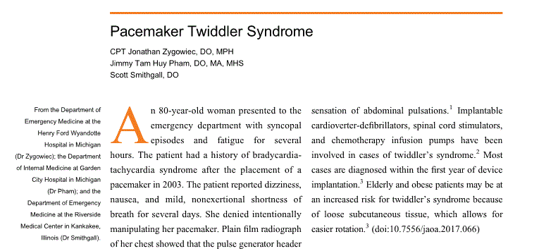

Pacemaker Twiddler Syndrome
Published in May 2017: Journal of the American Osteopathic Association
Jonathan Zygowiec, DO
Department of Emergency Medicine
Henry Ford Wyandotte Hospital
2016-2019
Journal of the American Osteopathic Association, May 2017, Vol. 117, No. 5, pg 339.

Slide 25
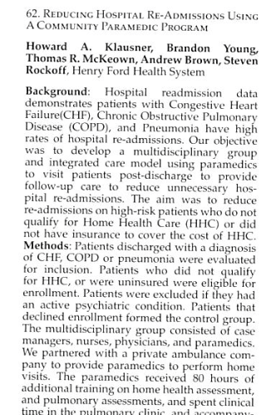
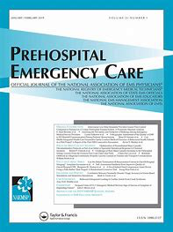
Reducing Hospital Re-Admissions Using A Community Paramedic Program
Abstract Published in January 2017: Prehospital Emergency Care
Thomas McKeown, MD, FACEP
Department of Emergency Medicine
Henry Ford Wyandotte Hospital
2003 - Present
Published in Prehospital Emergency Care Vol 21:1, Jan/Feb 2017, pg. 105
Presented Nationally at National Association of EMS Physicans Conference in Jacksonville, FL, January 2017.

Slide 26
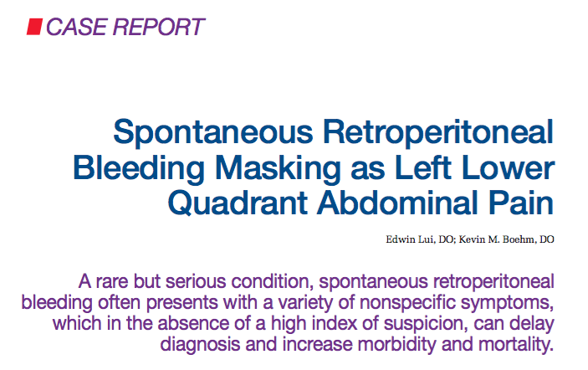

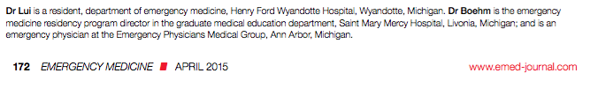

Spontaneous Retroperitoneal Bleeding Masking as Left Lower Quadrant Abdominal Pain
Published in April 2015: Emergency Medicine
Edwin Lui, D)
Department of Emergency Medicine
Henry Ford Wyandotte Hospital
2013-2017

Slide 27
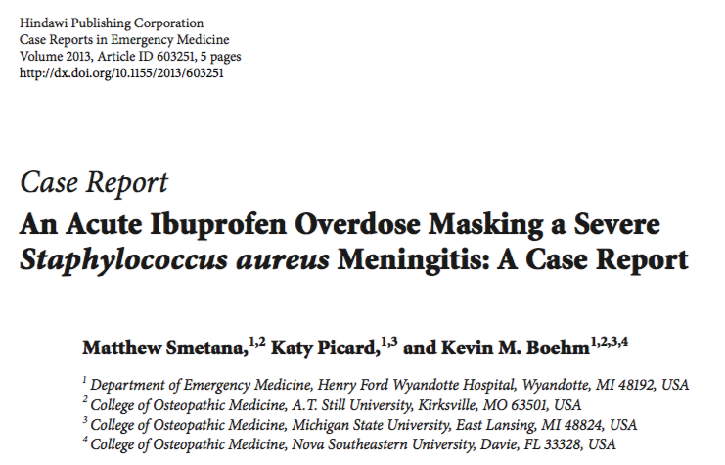
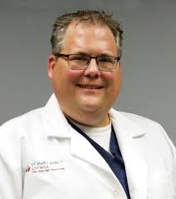

An Acute Ibuprofen Overdose Masking a Severe
Staphylococcus aureus Meningitis: A Case Report
Published in May 2013: Case Reports in Emergency Medicine
Kevin Boehm, DO, MPH
Department of Emergency Medicine
Henry Ford Wyandotte Hospital
2005 - 2014

Slide 28

Pacemaker Related Infective Endocarditis from Staphylococcus Lugdunesis: A Case Report
Published in January 2013: Case Reports in Critical Care
Kevin Boehm, DO, MPH
Department of Emergency Medicine
Henry Ford Wyandotte Hospital
2005 - 2014

Slide 29



The GENESIS Project
Published in March of 2012: Journal of Intensive Care Medicine

Slide 30




Author of Chapter 34: Mesenteric Ischaemia
Textbook of Emergency Medicine
Published November 2011
Satheesh Gunaga, DO, FACEP, FACOEP
Department of Emergency Medicine
Henry Ford Wyandotte Hospital
2005 - Present

Slide 31


Multi-State Toxicosurveillance of “Bath Salts” Presenting to the Emergency Department
Abstract Published in October 2011: Annals of Emergency Medicine
Christopher Nedzlek, DO, FACOEP
Department of Emergency Medicine
Henry Ford Wyandotte Hospital
2008 – Present
Published in Annals of Emergency Medicine, Vol. 58, No 4S, Oct. 2011, pg. S325
Presented Nationally at ACEP Scientific Assembly, October 2011.

Slide 32


Professional Fee Revenue Characteristics of
Frequent Users of the Emergency Department
Published in Annals of Emergency Medicine September 2010
Robert McCurren, MD, FACEP
Department of Emergency Medicine
Henry Ford Wyandotte Hospital
2004 – Present
Published in Annals of Emergency Medicine, Vol 56 No. 3, Sept 20010, pg. S127
Presented Nationally at ACEP Scientific Assembly, September 2010.

Slide 33





Cimetidine-Induced Lactic Acidosis and Acute Pancreatitis
Published in August Winter 2010: Southern Medical Journal
Satheesh Gunaga, DO, FACEP, FACOEP
Department of Emergency Medicine
Henry Ford Wyandotte Hospital
2005 - Present

Slide 34



Author of Chapter 8: Laboratory Diagnosis of Addicting Drugs
Textbook of Addictive Disorders in Medical Populations
Published in 2010
Satheesh Gunaga, DO, FACEP, FACOEP
Department of Emergency Medicine
Henry Ford Wyandotte Hospital
2005 - Present

Slide 35



Seasonal and Avian Influenza Knowledge Base of Attending Physicians in a Community-Based Hospital: A Survey-Based Study
Published in May 2010: Journal of the American Osteopathic Association
Kevin Boehm, DO, MPH
Department of Emergency Medicine
Henry Ford Wyandotte Hospital
2005 - 2014

Slide 36



Improving Outcomes in Severe Sepsis and Septic Shock
From the Multicenter Severe Sepsis and Septic Shock Collaborative Group
Published in September 2009: Journal Of Emergency Medicine
Won Top Prize for Best International Research Abstract of the Year
Satheesh Gunaga, DO, FACEP, FACOEP
Department of Emergency Medicine
Henry Ford Wyandotte Hospital
2005 - Present
Published in Journal of Emergency Medicine, Sept. 2009, Vol. 37, No 2, pg. 217
Presented Internationally in Valencia Spain in September 2009

Slide 37




Prevalence and Presentation of Septic Shock in the Prehospital Environment
S. Gunaga, DO, J. Walker, DO, J. Fletcher, DO, V. Kella, MD, B. Rosen, DO
Abstract Published in May 2009: Academic Emergency Medicine
Satheesh Gunaga, DO, FACEP, FACOEP
Department of Emergency Medicine
Henry Ford Wyandotte Hospital
2005 - Present
Published in Academic Emergency Medicine, May 2009, pg. S840
Presented Nationally at Society of Academic Emergency Medicine (SAEM) in New Orleans, May 2009.

Slide 38


Defining Sepsis Intervention Intervals in the Encounter of
Septic Shock in the Prehospital Environment
S. Gunaga, DO, J. Walker, DO, J. Fletcher, DO, V. Kella, MD, B. Rosen, DO
Abstract Published in January 2009: Prehospital Emergency Care
Satheesh Gunaga, DO, FACEP, FACOEP
Department of Emergency Medicine
Henry Ford Wyandotte Hospital
2005 - Present
Published in Prehospital Emergency Care, Jan/Mar 2009, pg. 118
Presented at National Association of EMS Physicians (NAEMSP) Conference in Jacksonville, FL, January 2009.

Slide 39


Implementation of a Sepsis Quality Initiative in a Community Hospital and Its Impact on Morbidity and Mortality in Septic Shock
S. Gunaga, DO, V. Kella, MD, C. Nedzlek, DO, M, Pensler, MD
Abstract Published in October 2008: Annals of Emergency Medicine
Satheesh Gunaga, DO, FACEP, FACOEP
Department of Emergency Medicine
Henry Ford Wyandotte Hospital
2005 – Present
Published in Annals of Emergency Medicine, Oct. 2008, pg. S840
Presented Nationally at ACEP Scientific Assembly, October 2008.
Christopher Nedzlek, DO, FACOEP
Department of Emergency Medicine
Henry Ford Wyandotte Hospital
2008 – Present

Slide 40


A New Variant of Wiiitis
Published in June 2008: The Journal of Emergency Medicine
Kevin Boehm, DO, MPH
Department of Emergency Medicine
Henry Ford Wyandotte Hospital
2005 - 2014

