Slide 1


Healthier, 2020
Where we are. Where we’re going.
How we’ll get there.
Abdul El-Sayed, MD, DPhil
Executive Director & Health Officer
Detroit Health Department
@AbdulElSayed
Notes:
Thank you Mayor Duggan.
It’s an honor and privilege to work with a Mayor who is so passionate about health and healthcare.
I want to situate our conversation today within a broader paradigm of public health – situated in my own experience as a public health scientist looking from the outside, and now in my role as a health director on the inside, looking out.

Slide 2
Public health is what we, as a society,
do collectively to assure the conditions
for people to be healthy
“
”
Institute of Medicine. The Future of Public Health. National Academy Press; Washington, D.C.: 1988

Slide 3
Public health is what we, as a society,
do collectively to assure the conditions
for people to be healthy
“
”
Public health is about context
Institute of Medicine. The Future of Public Health. National Academy Press; Washington, D.C.: 1988
Notes:
First, “conditions”—which tells us that public health is about contexts—situations in which people live, work, and go about the business of being human

Slide 4
Public health is what we, as a society,
do collectively to assure the conditions
for people to be healthy
“
”
Public health is about populations
Institute of Medicine. The Future of Public Health. National Academy Press; Washington, D.C.: 1988
Notes:
It’s also about people—collections, or groups of people

Slide 5
Public health is what we, as a society,
do collectively to assure the conditions
for people to be healthy
“
”
Public health is about health promotion vs disease cure
Institute of Medicine. The Future of Public Health. National Academy Press; Washington, D.C.: 1988
Notes:
And lastly, it’s about being healthy, rather than curing disease—so public health is about conditions in which groups of people live and how those conditions influence their capacity to be healthy

Slide 6


Notes:
But, given our interest in mankind as a collective, let us back up and think about the collective of patients—the popualtion.

Slide 7

Some are “high risk”
Low risk
High risk
Notes:
Some people are high risk—and this risk can be anything you want, maybe they’re men who have sex with men and we’re trying to prevent HIV infection, or hypertensives, and we’re trying to prevent heart attacks

Slide 8


Both “high risk” and others have disease
Low risk
High risk
Low risk with disease
High risk with disease
Notes:
Inevitably, some of the high risk people get disease, but so do some of the normal risk people. But the high risk people are more likely to get disease, that’s why they’re high risk!

Slide 9
Medicine.
Notes:
How does medicine think about preventing disease?

Slide 10
Prevalence
Risk factor
Rose G. The strategy of preventive medicine. Oxford: Oxford University Press; 1992.
Notes:
Well imagine all of those folks comprise the people under this bell curve, organized along high blood pressure.

Slide 11
Identify those who are high risk
Prevalence
Risk factor
Rose G. The strategy of preventive medicine. Oxford: Oxford University Press; 1992.
Notes:
In medicine, we draw an arbitrary line here, and we say that these people are high risk – the green people.

Slide 12
Identify those who are high risk
Prevalence
High Risk
Risk factor
Rose G. The strategy of preventive medicine. Oxford: Oxford University Press; 1992.

Slide 13

Then decrease their risk…
Notes:
We then counsel them. Ms Ma’am – you’re high risk, so we’re goiong to start you on a diuretic, or ACE-inhibitor, or something else, and we’re going to take care of you.

Slide 14
Then decrease their risk…
Prevalence
Risk factor
Rose G. The strategy of preventive medicine. Oxford: Oxford University Press; 1992.
Notes:
At best, we blunt the risk distribtuion—bring all of the high risk folks back under the “normal risk” umbrella.

Slide 15
Then decrease their risk…
Prevalence
Unaddressed underlying risk
Risk factor
Rose G. The strategy of preventive medicine. Oxford: Oxford University Press; 1992.
Notes:
But that still leaves a high proportion of unaddressed underlying risk—remember all the blue people in our village who also got the disease?

Slide 16
The medical strategy sees this…
Low risk
High risk
Low risk with disease
High risk with disease
Notes:
So while the medical approach sees all of this…

Slide 17
…but misses all of this
Low risk
High risk
Low risk with disease
High risk with disease
Notes:
It, by definition, misses all of this.

Slide 18
Public health.
Notes:
Now, let’s look at how we prevent disease in populations

Slide 19
The public health strategy
Prevalence
Risk factor
Rose G. The strategy of preventive medicine. Oxford: Oxford University Press; 1992.
Notes:
Let’s compare that to a broader public health strategy focusing on people in places.

Slide 20
Shift the entire risk distribution
Prevalence
Risk factor
Rose G. The strategy of preventive medicine. Oxford: Oxford University Press; 1992.
Notes:
What if we could just shift the entire distribution curve such that everyone, those who were high and low risk enjoyed a risk decrease?

Slide 21
The public health strategy…
Low risk
High risk
Notes:
What would happen to our population? It would move from this,

Slide 22
The public health strategy…
Low risk
High risk
Notes:
To this, and ultimately, the population would experience substantailly less of this:

Slide 23
The public health strategy…
Low risk
High risk
Low risk with disease
High risk with disease

Slide 24
Public health is what we, as a society,
do collectively to assure the conditions
for people to be healthy
“
”
Public health is about context
Institute of Medicine. The Future of Public Health. National Academy Press; Washington, D.C.: 1988
Notes:
Remember, public health is about context – it’s about creating the conditions that shift the distribution that I showed you above.

Slide 25
Context for consideration.
Notes:
What does that mean in Detroit?

Slide 26

Notes:
JAMA recently published a thoughtful article by some economists at Stanford, that looked at health disparities in different cities. They found that while the rich live longer everywhere, for the poor, geography matters a lot.

Slide 27
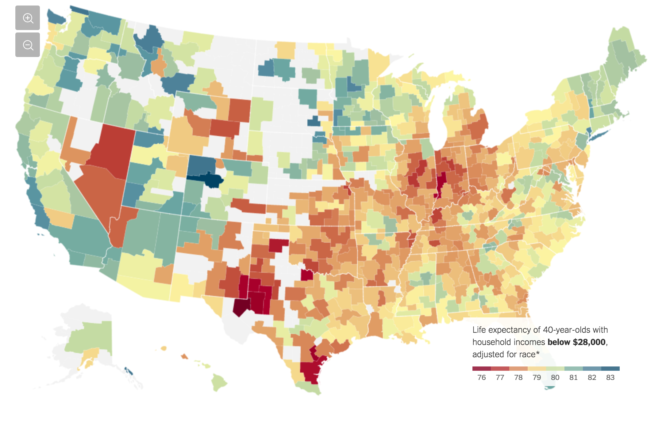
Notes:
Here you see life expectancy among people under 40 with household income below 28K. Notice our region has some of the lowest rates.

Slide 28
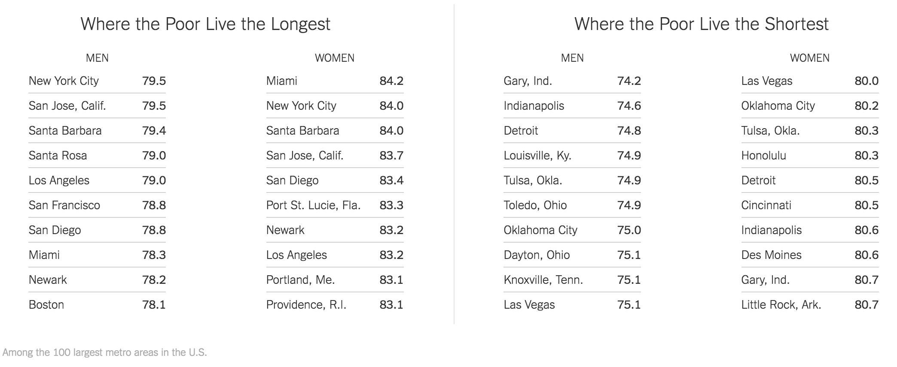
Notes:
Here you see Cities by longest and shortest lives among men and women. You see Detroit is among the shortest among men and women.

Slide 29
Notes:
Here you see Cities by longest and shortest lives among men and women. You see Detroit is among the shortest among men and women.

Slide 30
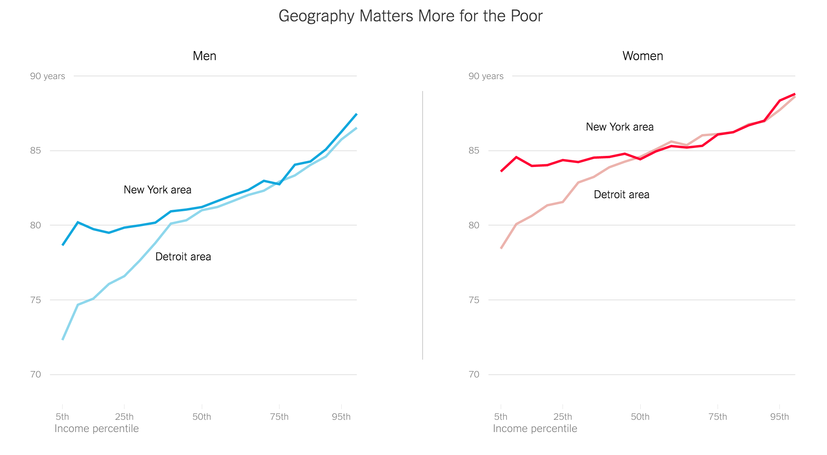
Notes:
And here they contrasted Detroit and New york. What you’re seeing is life expectancy on the Y adis and income on the X axis in Detroit in New York. You’ll see that among the rich, Detroiters and New Yorkers lived relatively similar life expectancies. However, once you fall below the 50th percentile, poor Detroiters live far shorter lives. Why?
Let’s compare Detroit with the Bronx, the poorest burrough in NYC.

Slide 31
Detroit vs the Bronx.
Notes:
Here you see some of the more important metrics we use to consider various aspects of poverty – segregation of minorities, owner occupied housing, % with a bachelors degree, % in labor force, and % below poverty. You’ll note that Detroit and the Bronx look similar, statistically. But let’s look at what they look like in real life.

Slide 32
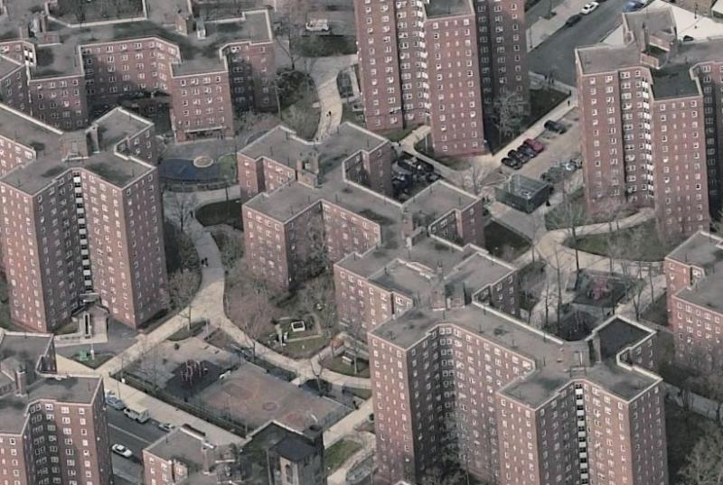
The Bronx.
Notes:
This is the Bronx, huge multifamily complexes, with really high density.

Slide 33
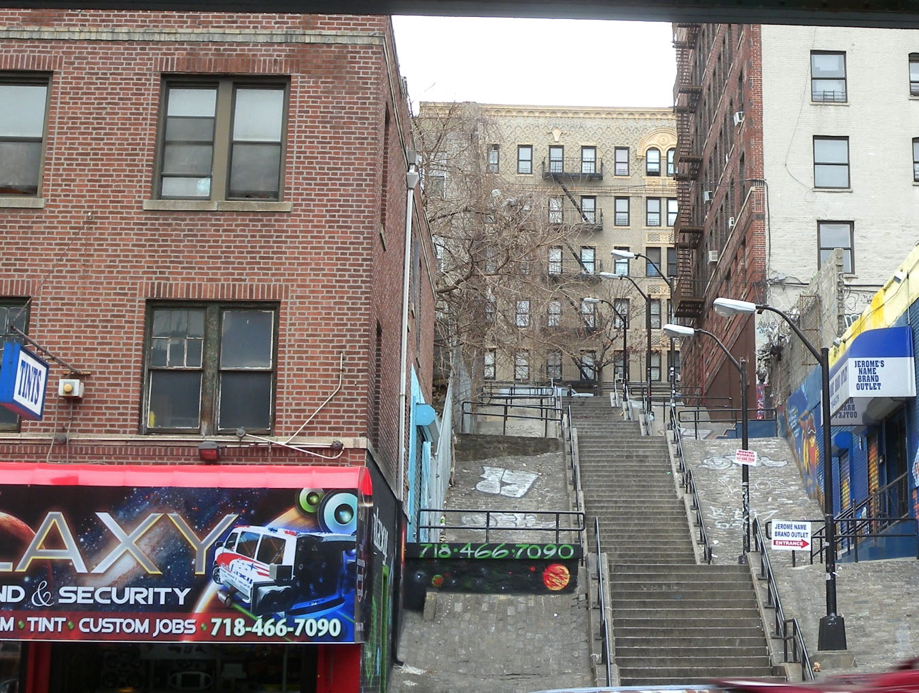
The Bronx.
Notes:
And here’ swhat it look slike on the ground. Housing and commercial outlets.

Slide 34
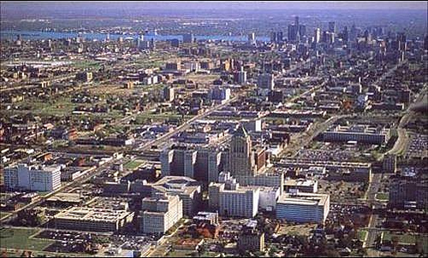
Detroit.
Notes:
Compare that to Detroit – which looks like this from the air.

Slide 35
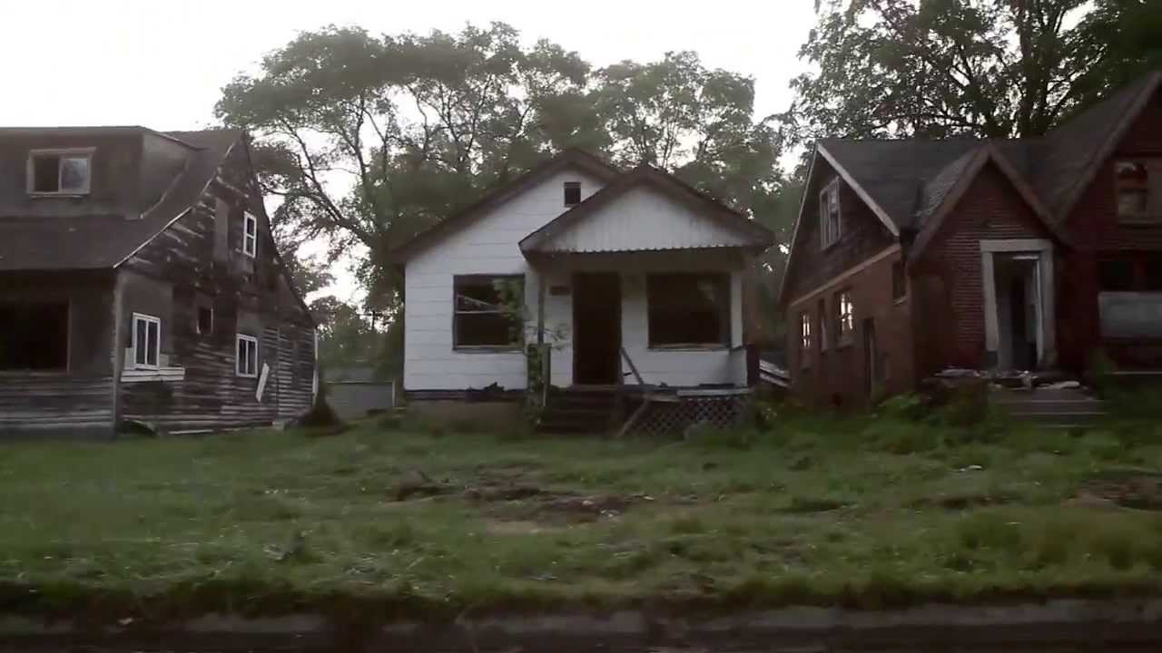
Detroit.
Notes:
And this on the ground – it echoes many of the points we were making earlier about density in our community.

Slide 36
Where we are.
Notes:
What does that mean in Detroit?

Slide 37
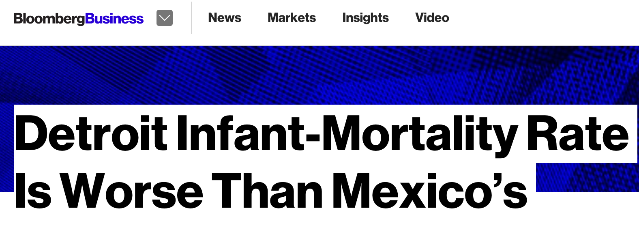
Notes:
And lastly, Detroit’s staggering murder and violent crime rate are a public health issue.

Slide 38
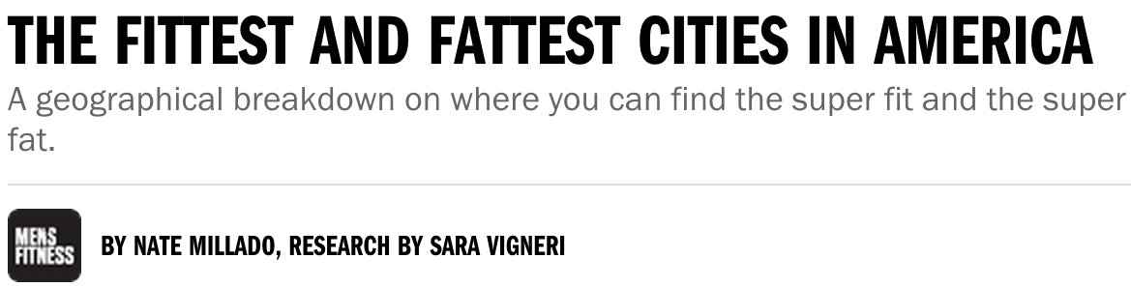
Notes:
And lastly, Detroit’s staggering murder and violent crime rate are a public health issue.

Slide 39
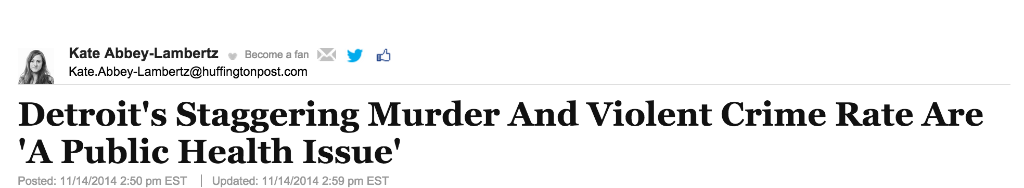
Notes:
And lastly, Detroit’s staggering murder and violent crime rate are a public health issue.

Slide 40
Why?
Notes:
Given the many public health challenges we face, including infant mortality, obesity, homicide, asthma, lead, etc. Why is it that we see that Detroit suffers some of the highest rates in the country?

Slide 41
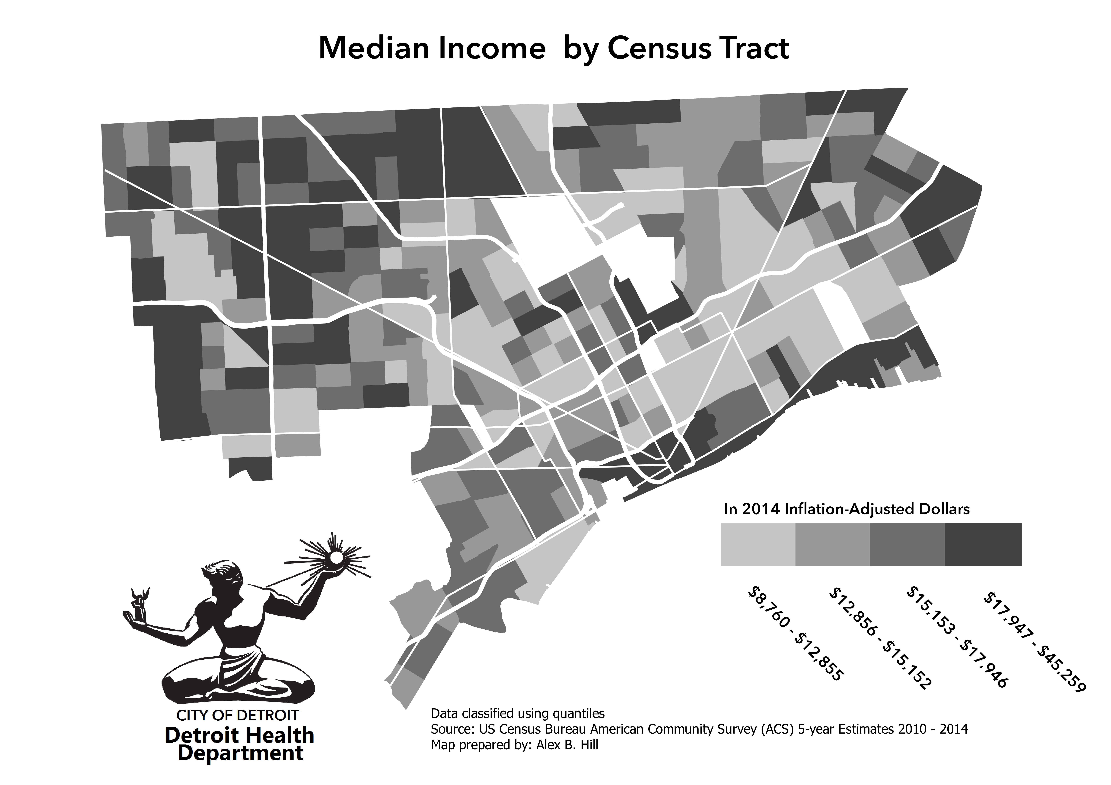
Notes:
And the answer has to do with context. We see here median income by census tract. We know that the median income in Detroit is low, and this is a low-income community. And we see that poverty maps to many of the challenges we face.
But it’s not just poverty. There are other poor cities in the country – they include Baltimore, Oakland, and DC. But our City ranks among the top when we talk about bad health outcomes.

Slide 42
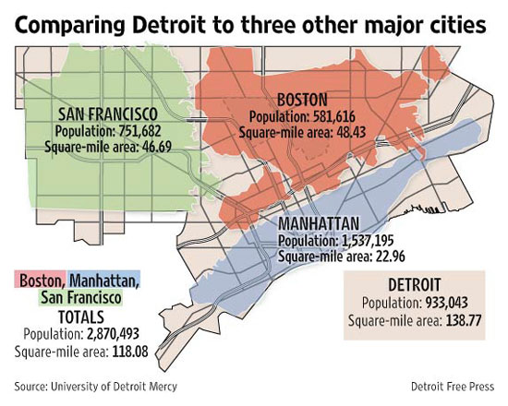
Notes:
It’s also that the City is gigantic – we could fit all of Boston, Manhattan, and San Francisco into Detroit, and have room to spare. So we have low-income people in a huge place.

Slide 43
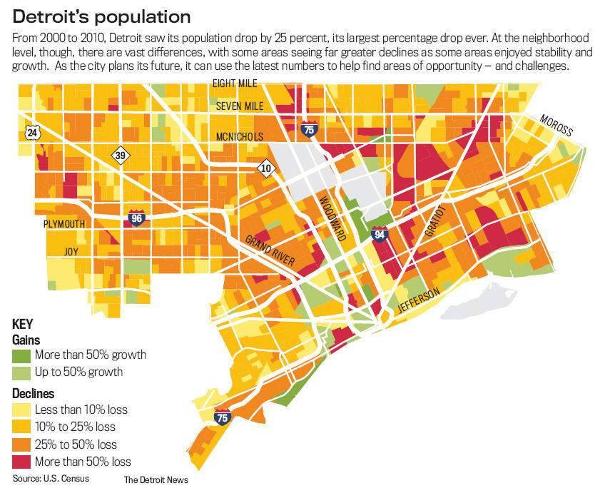
Notes:
Worse, that space is highly vacant. Here you see the percentage of the population gained or lost in Detroit between 2000-2010. And you see that nearly all of Detroit has lost population. And when vacancy happens, it’s not just that who blocks at the time displace, it’s that you live in the same place for 20 years, and all of sudden, you look right, you look left, and you’re one of two occupied houses on the block. So, we have low-income communities, in a huge space, that is largely unoccupied.

Slide 44
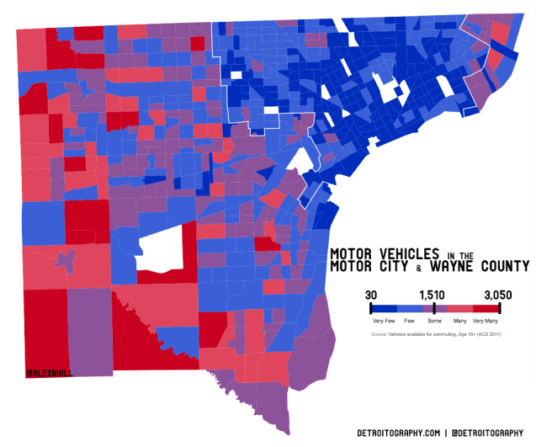
Notes:
And that the tragic irony of the motor city is that almost no one can count on a car. This map shows Detroit up here, compared to the rest of wayne county. 40% of Detroiters don’t have a car, another 40% don’t have regular access to one.

Slide 45
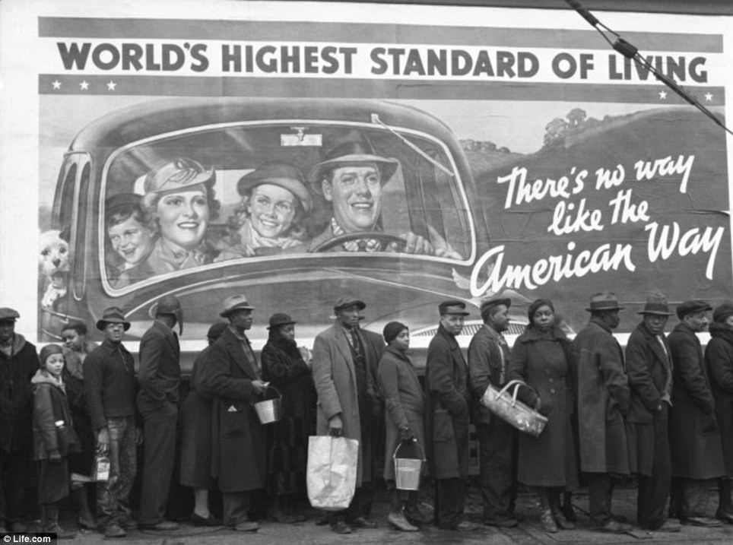
Notes:
And much of this is the consequence of decades of decisions in the past that marginalized low-income minorities for the benefit for high-income whites.
Here in lies the challenge of public health in Detroit – addressing challenges of density, of transportation, and of poverty. The question we have before us is how do we build public health in Detroit

Slide 46
Obstacles.
Education & Employment. Health is a consequence of social wellbeing. Improving the health of disadvantaged communities is more difficult.
Communities. Health behaviors are reinforced in communities. Counteracting negative community influences is challenging.
Neighborhoods. Vacancy, blight, and transport challenges are a reality in Detroit. These have created the context for poor health.

Slide 47
Obstacles.
Education & Employment. Health is a consequence of social wellbeing. Improving the health of disadvantaged communities is more difficult.
Communities. Health behaviors are reinforced in communities. Counteracting negative community influences is challenging.
Neighborhoods. Vacancy, blight, and transport challenges are a reality in Detroit. These have created the context for poor health.

Slide 48
Obstacles.
Education & Employment. Health is a consequence of social wellbeing. Improving the health of disadvantaged communities is more difficult.
Communities. Health behaviors are reinforced in communities. Counteracting negative community influences is challenging.
Neighborhoods. Vacancy, blight, and transport challenges are a reality in Detroit. These have created the context for poor health.

Slide 49
Obstacles.
Education & Employment. Health is a consequence of social wellbeing. Improving the health of disadvantaged communities is more difficult.
Communities. Health behaviors are reinforced in communities. Counteracting negative community influences is challenging.
Neighborhoods. Vacancy, blight, and transport challenges are a reality in Detroit. These have created the context for poor health.

Slide 50
Obstacles.
Education & Employment. Health is a consequence of social wellbeing. Improving the health of disadvantaged communities is more difficult.
Communities. Health behaviors are reinforced in communities. Counteracting negative community influences is challenging.
Neighborhoods. Vacancy, blight, and transport challenges are a reality in Detroit. These have created the context for poor health.

Slide 51
Opportunities.
Education & Employment. Health is a consequence of social wellbeing. Improving social wellbeing will also improve health.
Communities. Health behaviors are reinforced in communities. Communities can be leveraged to improve and reinforce health.
Neighborhoods. Vacancy, blight, and transport challenges are a reality in Detroit. Focusing on neighborhoods can improve health in Detroit.

Slide 52
Opportunities.
Education & Employment. Health is a consequence of social wellbeing. Improving social wellbeing will also improve health.
Communities. Health behaviors are reinforced in communities. Communities can be leveraged to improve and reinforce health.
Neighborhoods. Vacancy, blight, and transport challenges are a reality in Detroit. Focusing on neighborhoods can improve health in Detroit.

Slide 53
Opportunities.
Education & Employment. Health is a consequence of social wellbeing. Improving social wellbeing will also improve health.
Communities. Health behaviors are reinforced in communities. Communities can be leveraged to improve and reinforce health.
Neighborhoods. Vacancy, blight, and transport challenges are a reality in Detroit. Focusing on neighborhoods can improve health in Detroit.

Slide 54
Opportunities.
Education & Employment. Health is a consequence of social wellbeing. Improving social wellbeing will also improve health.
Communities. Health behaviors are reinforced in communities. Communities can be leveraged to improve and reinforce health.
Neighborhoods. Vacancy, blight, and transport challenges are a reality in Detroit. Focusing on neighborhoods can improve health in Detroit.

Slide 55
Opportunities.
Education & Employment. Health is a consequence of social wellbeing. Improving social wellbeing will also improve health.
Communities. Health behaviors are reinforced in communities. Communities can be leveraged to improve and reinforce health.
Neighborhoods. Vacancy, blight, and transport challenges are a reality in Detroit. Focusing on neighborhoods can improve health in Detroit.

Slide 56
And also...

Slide 57











And also...

Slide 58
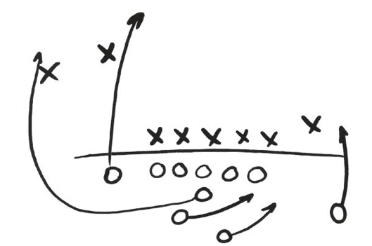
And also...

Slide 59
Where we’re going.

Slide 60
Where we’re going.
1. Reinvigorating the institutional, fiscal, and functional base of public health for the future.
2. Moving public health into the neighborhoods where Detroiters live, work, and play.
3. Reframing Motown: from the example of the health consequences of urban decay to an example of ‘public health 2.0’: innovative, forward looking public health policy.

Slide 61
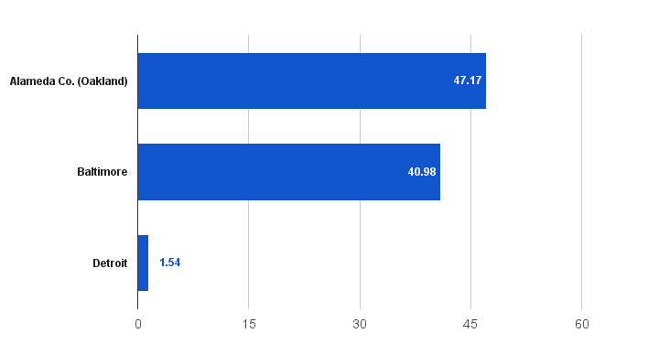
Public health general fund dollars/person.

Slide 62
Where we’re going.
1. Reinvigorating the institutional, fiscal, and functional base of public health for the future.
2. Moving public health into the neighborhoods where Detroiters live, learn, work, and play.
3. Reframing Motown: from the example of the health consequences of urban decay to an example of ‘public health 2.0’: innovative, forward looking public health policy.

Slide 63
Where we’re going.
1. Reinvigorating the institutional, fiscal, and functional base of public health for the future.
2. Moving public health into the neighborhoods where Detroiters live, learn, work, and play.
3. Reframing Motown: from the example of the health consequences of urban decay to an example of ‘public health 3.0’: innovative, forward looking public health policy.

Slide 64
How we’ll get there.

Slide 65
A culture of excellence.

Slide 66
A culture of excellence.
Accountable. Transparent. Collaborative.

Slide 67
Building a process.
Yoking our programs to data
Improving our organizational structure
Committing ourselves to feedback, adaptation, continual improvement
Communication – internal and external
Focusing on our customer

Slide 68
Building a process.
A coherent organizational structure
Yoking our programs to data
Committing ourselves to feedback, adaptation, continual improvement
Communicating
Pulsing with the community
Deep innovation
Building on momentum
Working together

Slide 69
Building a process.
A coherent organizational structure
Yoking our programs to data
Committing ourselves to feedback, adaptation, continual improvement
Communicating
Pulsing with the community
Deep innovation
Building on momentum
Working together

Slide 70
Health policy/planning
Special projects
Healthier Maternity
Healthier Lives
Animal Care/Control
Healthier Childhoods
Healthier places
Notes:
To illustrate what I mean by that, let’s consider a couple of scenarios—regarding specific patients who present to your ED with crushing substernal chest pain, diaphoresis, and SOB

Slide 71
Health policy/planning
Special projects
Healthier Maternity
Healthier Lives
Animal Care/Control
Healthier Childhoods
Healthier places
Notes:
To illustrate what I mean by that, let’s consider a couple of scenarios—regarding specific patients who present to your ED with crushing substernal chest pain, diaphoresis, and SOB

Slide 72
Building a process.
A coherent organizational structure
Yoking our programs to data
Committing ourselves to feedback, adaptation, continual improvement
Communicating
Pulsing with the community
Deep innovation
Building on momentum
Working together

Slide 73
Health policy/planning
Special projects
Healthier Maternity
Healthier Lives
Animal Care/Control
Healthier Childhoods
Healthier places
Notes:
To illustrate what I mean by that, let’s consider a couple of scenarios—regarding specific patients who present to your ED with crushing substernal chest pain, diaphoresis, and SOB

Slide 74
Health policy/planning
Collect, analyze metrics
Research statutes, ordinances
Engage evaluation partners
Special projects
Write grants to support programs
Coordinate cross-cluster programs
Engage community collaborators
Healthier Maternity
⬇ Infant mortality
⬇ Matern mortality
⬇ Teen Pregnancy
⬆LARCs placed
Healthier Lives
⬇ DM2 amputation
⬇ CDs readmission
⬇ New HIV cases
⬇ Opioid OD deaths
Animal Care/Control
⬇ Dog bites
⬆Live release rate
⬆Licenses
Healthier Childhoods
⬇ Asthma ED visits
⬇ Elevated lead %
⬆Immunization rate
⬆WIC enrollment
Healthier places
⬇ Emissions
⬆Inspections
⬆Food grades given
⬇ Homicide
⬆Primary care visits

Slide 75
Building a process.
A coherent organizational structure
Yoking our programs to data
Committing ourselves to feedback, adaptation, continual improvement
Communicating
Pulsing with the community
Deep innovation
Building on momentum
Working together

Slide 76
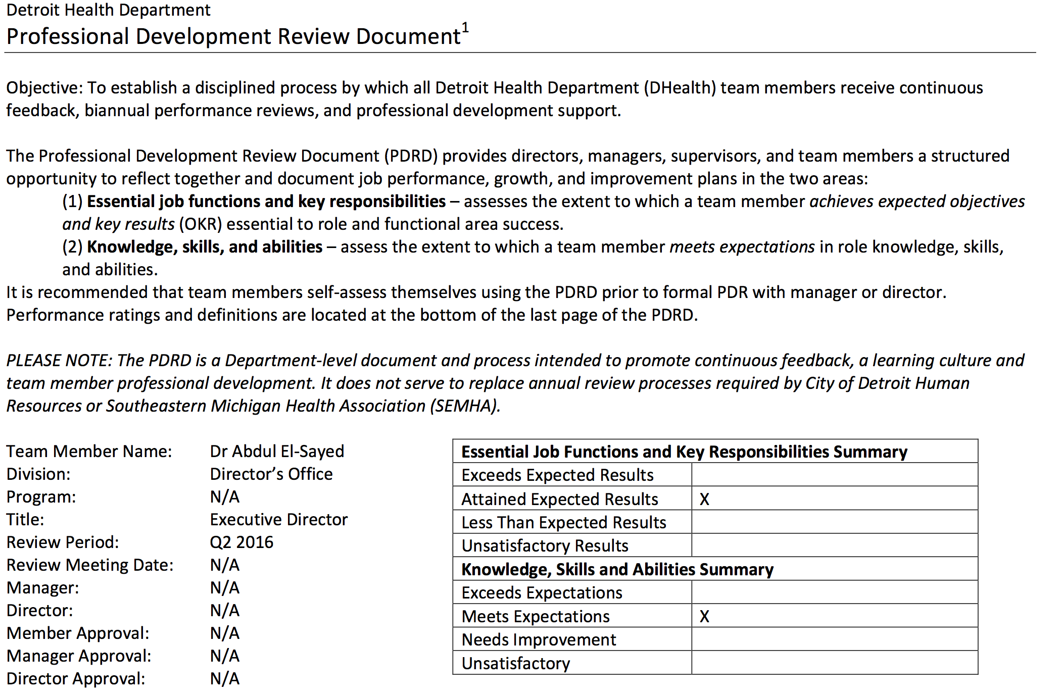

Slide 78
Building a process.
A coherent organizational structure
Yoking our programs to data
Committing ourselves to feedback, adaptation, continual improvement
Communicating
Pulsing with the community
Deep innovation
Building on momentum
Working together

Slide 79

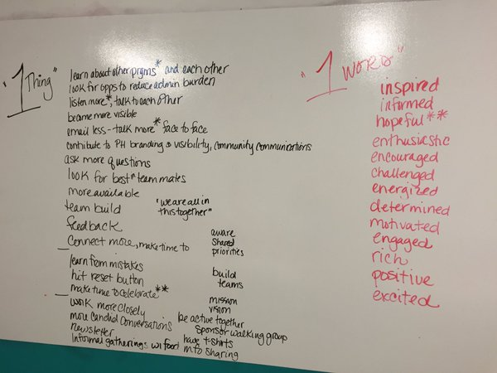
Notes:
To illustrate what I mean by that, let’s consider a couple of scenarios—regarding specific patients who present to your ED with crushing substernal chest pain, diaphoresis, and SOB

Slide 80
Building a process.
A coherent organizational structure
Yoking our programs to data
Committing ourselves to feedback, adaptation, continual improvement
Communicating
Pulsing with the community
Deep innovation
Building on momentum
Working together

Slide 81
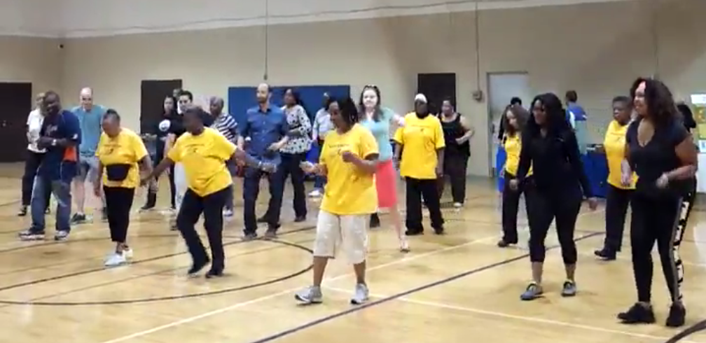
Notes:
To illustrate what I mean by that, let’s consider a couple of scenarios—regarding specific patients who present to your ED with crushing substernal chest pain, diaphoresis, and SOB

Slide 82
Building a process.
A coherent organizational structure
Yoking our programs to data
Committing ourselves to feedback, adaptation, continual improvement
Communicating
Pulsing with the community
Deep innovation
Building on momentum
Working together

Slide 83
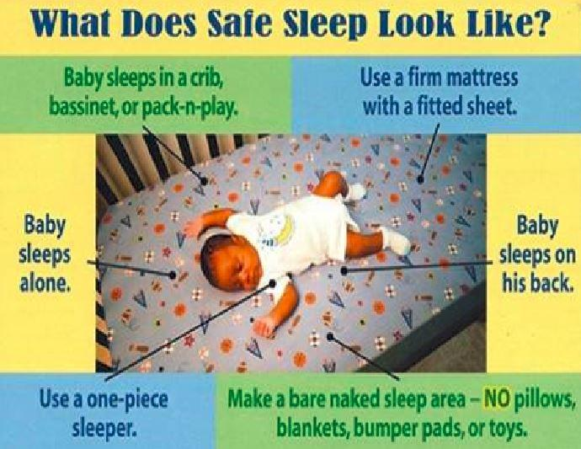
Notes:
To illustrate what I mean by that, let’s consider a couple of scenarios—regarding specific patients who present to your ED with crushing substernal chest pain, diaphoresis, and SOB

Slide 84
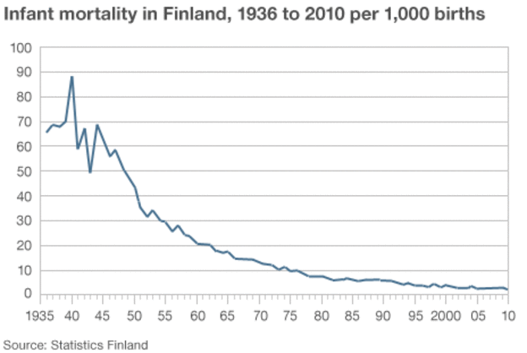
Detroit - 2015
Notes:
To illustrate what I mean by that, let’s consider a couple of scenarios—regarding specific patients who present to your ED with crushing substernal chest pain, diaphoresis, and SOB

Slide 85

Notes:
To illustrate what I mean by that, let’s consider a couple of scenarios—regarding specific patients who present to your ED with crushing substernal chest pain, diaphoresis, and SOB

Slide 86
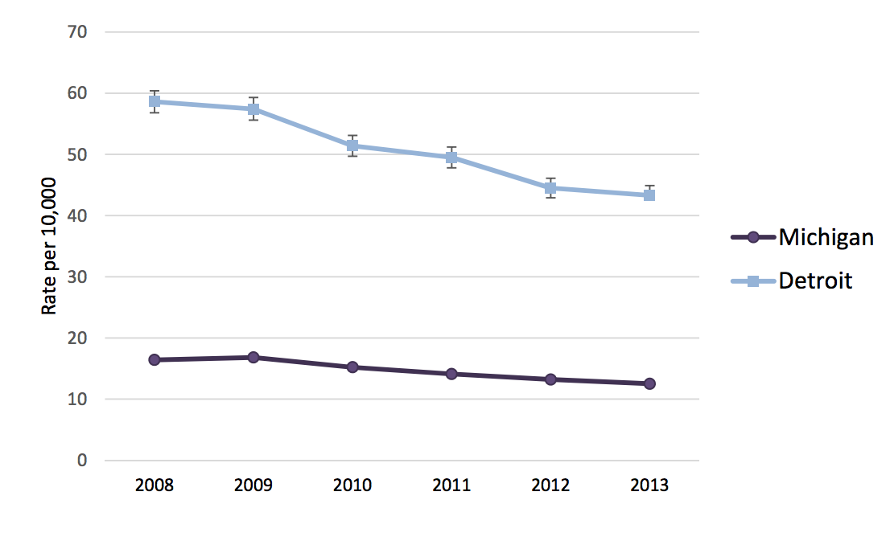
Asthma hospitalizations.

Slide 87
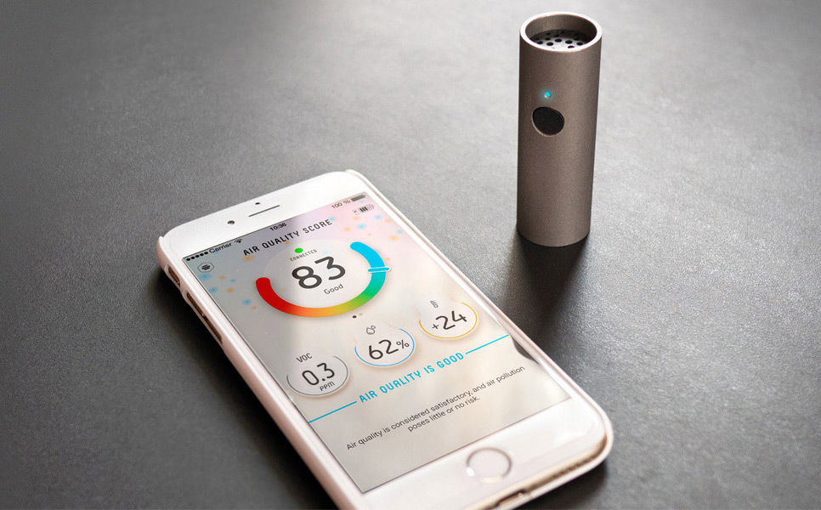

Slide 88
Notes:
And that the tragic irony of the motor city is that almost no one can count on a car. This map shows Detroit up here, compared to the rest of wayne county. 40% of Detroiters don’t have a car, another 40% don’t have regular access to one.

Slide 89
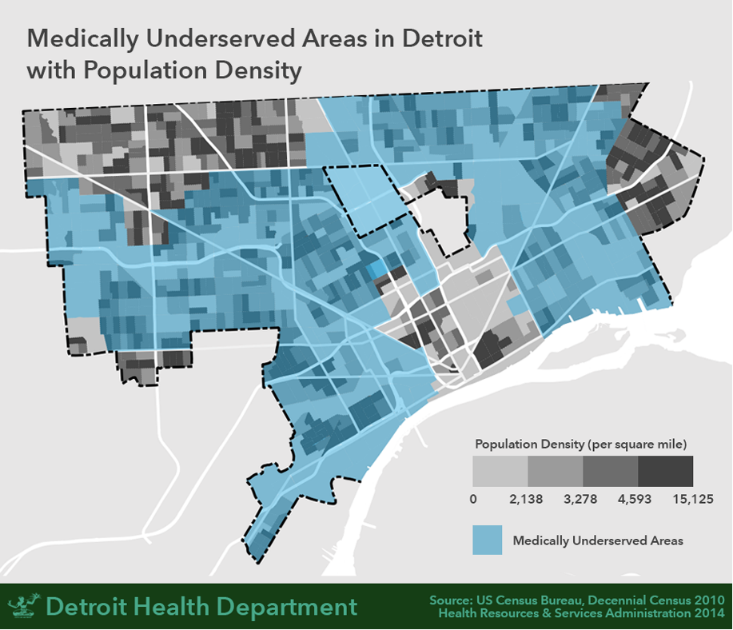

Slide 90


Slide 91
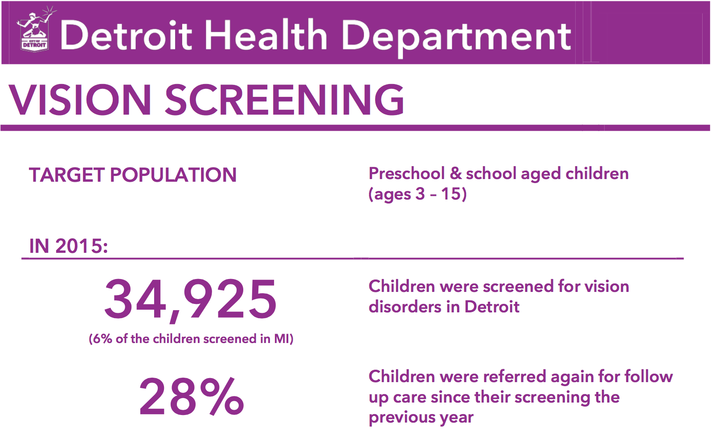

Slide 92
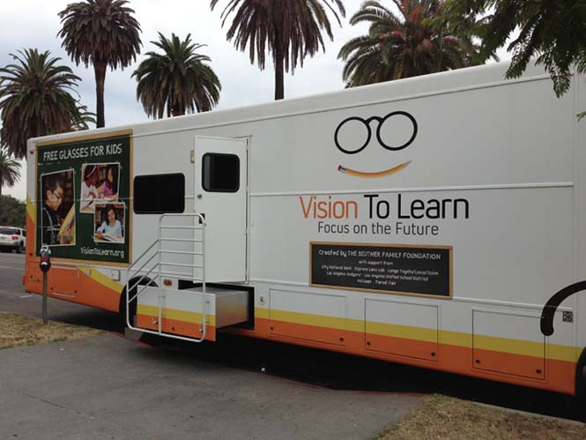
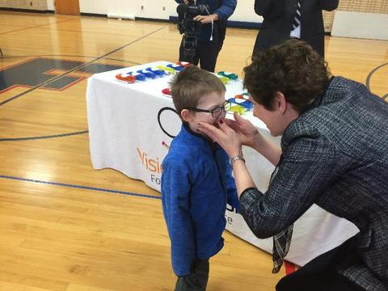

Slide 93
Building a process.
A coherent organizational structure
Yoking our programs to data
Committing ourselves to feedback, adaptation, continual improvement
Communicating
Pulsing with the community
Deep innovation
Building on momentum
Working together

Slide 94
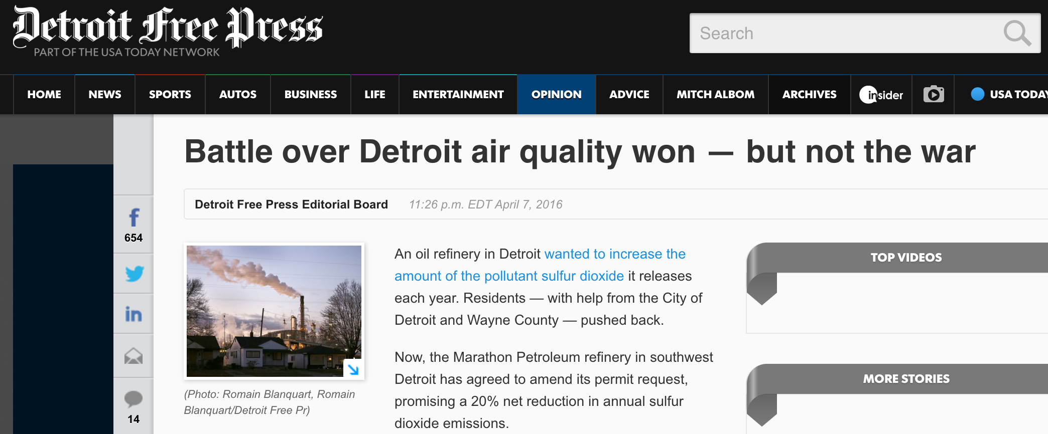
Building on momentum.

Slide 95
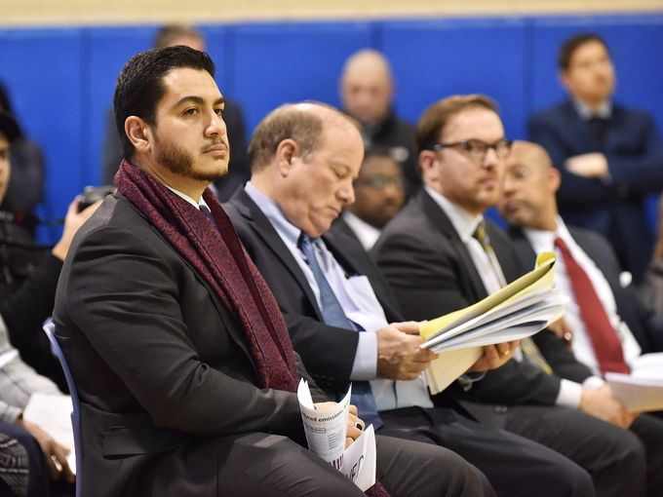
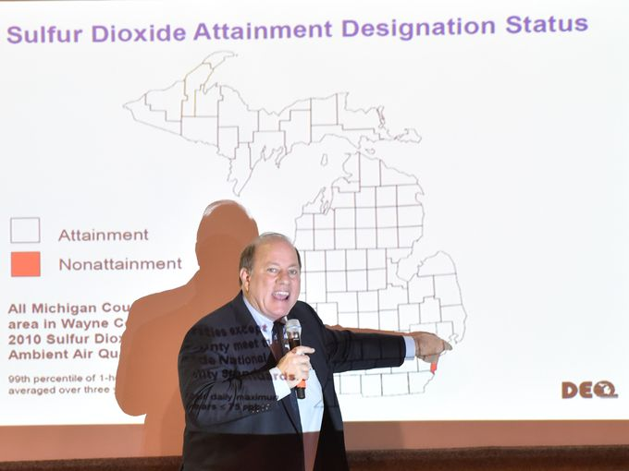
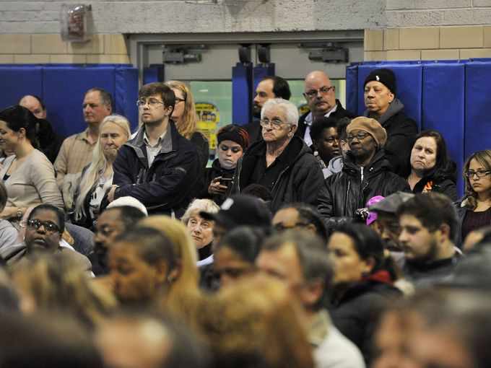

Slide 96
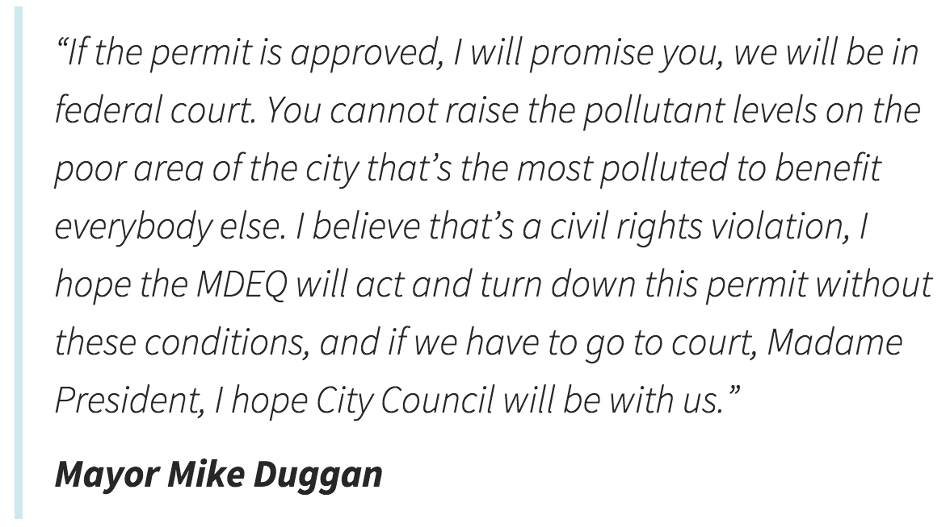

Slide 97
Marathon submits.
$10M investment to reduce emissions
Decrease in requested and expected emissions
Voluntary 20% reduction in permitted SO₂ emissions

Slide 98
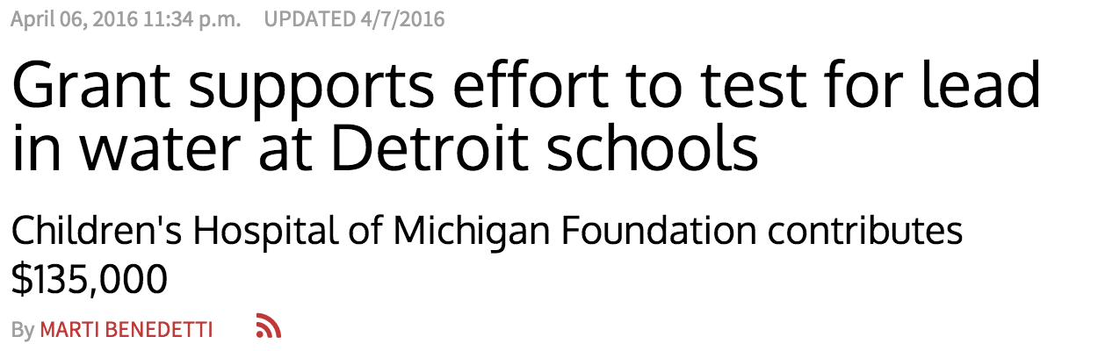
Building on momentum.

Slide 99
Lead Safe Detroit.
Convened citywide coalition – BSEED, HRD, DWSD, DLBA, GHHI, ClearCorps to coordinate
Reinitiated testing by City – first tests since 2011
Coordinated Detroit-wide school water testing – currently to 94% compliance across 400 schools

Slide 100
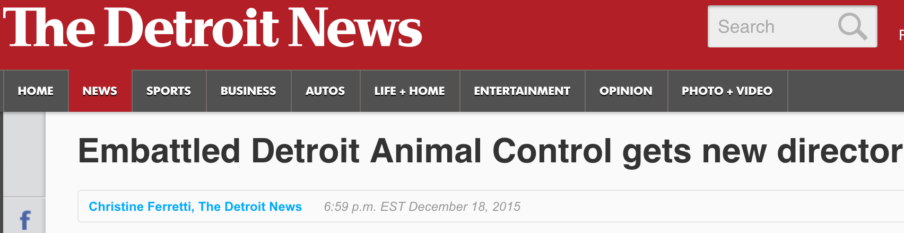
Building on momentum.

Slide 101
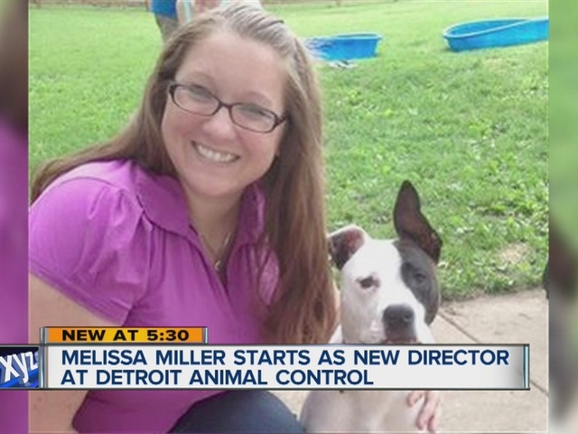
Animal control.

Slide 102
Animal control.
Budget increases 2x in July – will allow for expanded service hours
Soft launch of online licensing completed
License amnesty program launched
Moving to new facility in August
Dog bites down 29%
Live release rate up from 14% to 67%

Slide 103
Working together.

Slide 104
Working together.

Slide 105
Working together.
Health systems are critical partners to accomplishing shared goal of a healthier Detroit.
Coordination solves collective action problems – where government should play.
We aim to work together to scale and coordinate the great work that health systems are already leading.
New Medical Director from Baltimore City to lead our Health Systems Engagement.

Slide 106

Heals
Notes:
But all is not lost. What we are doing here to day is coming together to understand how to build the kind of ocntext – across public space, and commerce, and community engagement to build the context to address publci health. The good news, is that Detroit Hustles harder – and if we do that, we can heal harder too.

